Slide 1
Design and Analysis of Algorithm
Dynamic Programming
(0/1 knapsack problem, All pair shortest path)
Lecture – 54

Slide 2
Overview
Dynamic Programming is a general algorithm design technique for solving problems defined by recurrences with overlapping subproblems
Invented by American mathematician “Richard Bellman) in the year 1950s to solve optimization problems and later assimilated by Computer Science.
“Programming” here means “planning”

Slide 3
Dynamic Programming
“Method of solving complex problems by breaking them down into smaller sub-problems, solving each of those sub-problems just once, and storing their solutions.”
The problem solving approach looks like Divide and conquer approach.(which is not true)

Slide 4
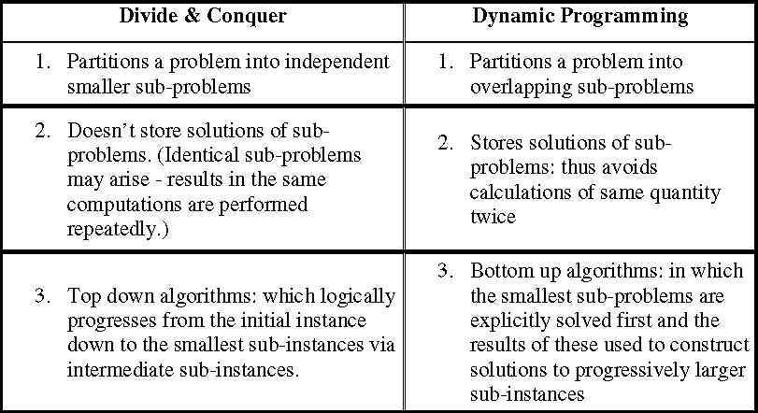
Dynamic Programming
Difference between Dynamic programming and Divide and Conquer approach.

Slide 5
Dynamic Programming
Is a Four-step methods
1. Characterize the structure of an optimal solution.
2. Recursively define the value of an optimal solution.
3. Compute the value of an optimal solution, typically in a bottom-up fashion.
4. Construct an optimal solution from computed information.

Slide 6
Dynamic Programming
Problems:
1. 0/1 Knapsack Problem
2. Floyd-Warshall Algorithm
Matrix Chain Multiplication
Longest Common Sub-sequence

Slide 7
Dynamic Programming
Problem 1: 0/1 Knapsack Problem
As the name suggests, items are indivisible here.
We can not take the fraction of any item.
We have to either take an item completely or leave it completely.
It is solved using dynamic programming approach.
Lets solve with four step methods:

Slide 8
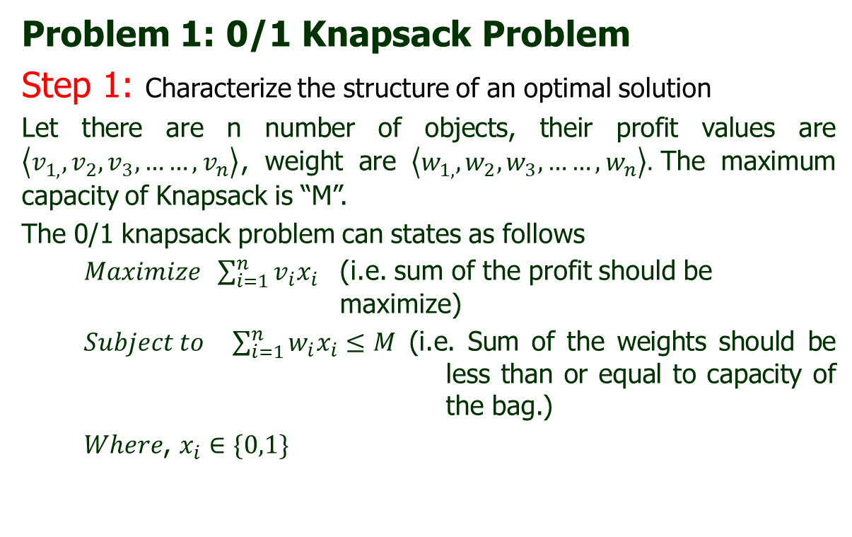
Dynamic Programming
Problem 1: 0/1 Knapsack Problem
Step 1: Characterize the structure of an optimal solution
Let there are n number of objects, their profit values are $\left\langle v_{1, },v_{2},v_{3},……,v_{n}\right\rangle$, weight are $\left\langle w_{1, },w_{2},w_{3},……,w_{n}\right\rangle .$The maximum capacity of Knapsack is “M”.
The 0/1 knapsack problem can states as follows
$Maximize \sum_{i=1}^{n}{v_{i}x_{i}}$ (i.e. sum of the profit should be maximize)
$Subject to \sum_{i=1}^{n}{w_{i}x_{i}}≤M$ (i.e. Sum of the weights should be less than or equal to capacity of the bag.)
$Where$, $x_{i}∈\{0,1\}$

Slide 9
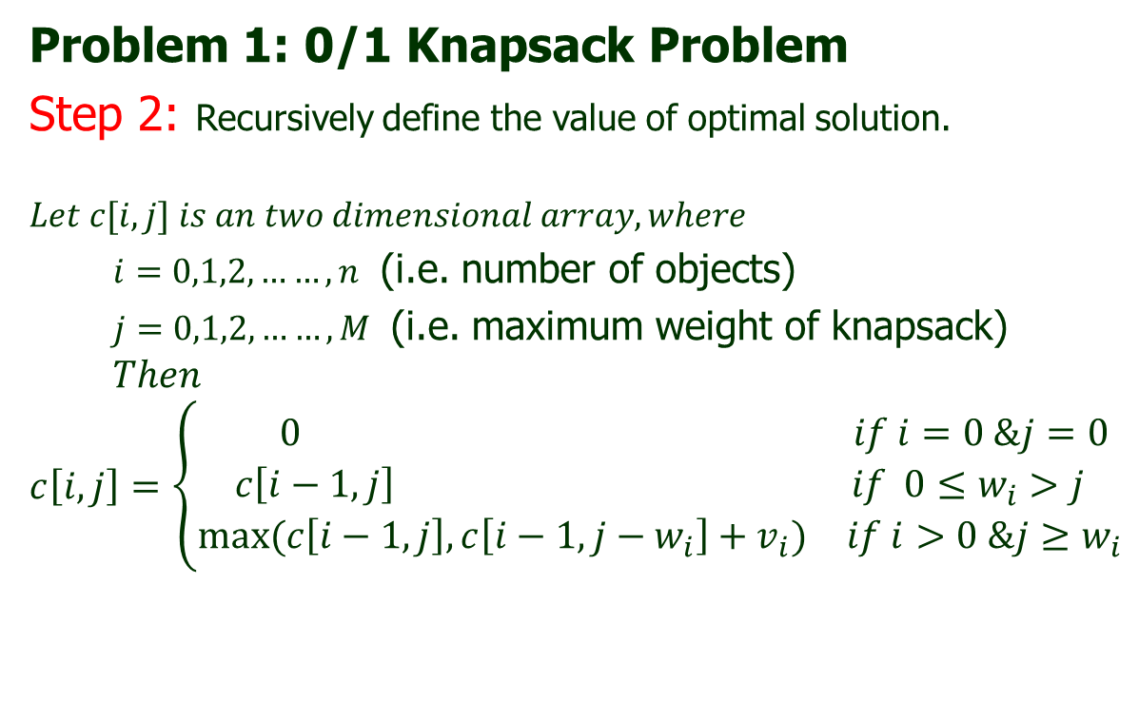
Dynamic Programming
Problem 1: 0/1 Knapsack Problem
Step 2: Recursively define the value of optimal solution.
$$Let c[i,j] is an two dimensional array, where$$
$i=0,1,2,……,n$ (i.e. number of objects)
$j=0,1,2,……,M$ (i.e. maximum weight of knapsack)
$$Then$$
$$c\left[i,j\right]=\left\{\begin{aligned} \begin{matrix}0 & if i=0 \&j=0\end{matrix} \\ \begin{matrix}c\left[i−1,j\right] & if{ 0≤w}_{i}>j\end{matrix} \\ \begin{matrix}max⁡(c\left[i−1,j\right],c\left[i−1,j−w_{i}\right]+v_{i}) & if i>0 \&j≥w_{i}\end{matrix}\end{aligned}\right.$$

Slide 10
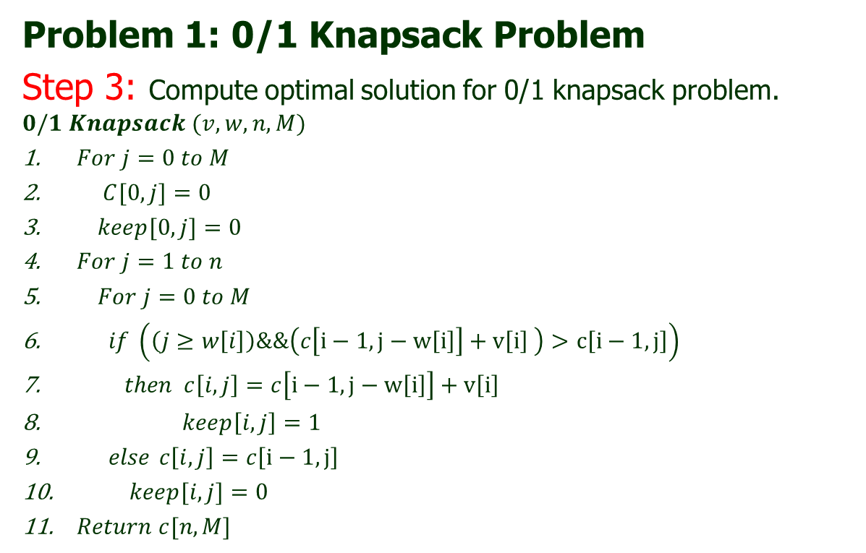
Dynamic Programming
Problem 1: 0/1 Knapsack Problem
Step 3: Compute optimal solution for 0/1 knapsack problem.
$$0/1 Knapsack (v,w,n,M)$$
$For j=0 to M$
$C[0,j]=0$
$keep[0,j]=0$
$For j=1 to n$
$For j=0 to M$
$if \left(\left(j≥w\left[i\right]\right)\&\&\left(c\left[i−1,j−w\left[i\right]\right]+v\left[i\right] \right)>c\left[i−1,j\right]\right)$
$then c\left[i,j\right]=c\left[i−1,j−w\left[i\right]\right]+v\left[i\right]$
$keep\left[i,j\right]=1$
$else$ $c\left[i,j\right]=c\left[i−1,j\right]$
$keep[i,j]=0$
$Return c[n,M]$

Slide 11
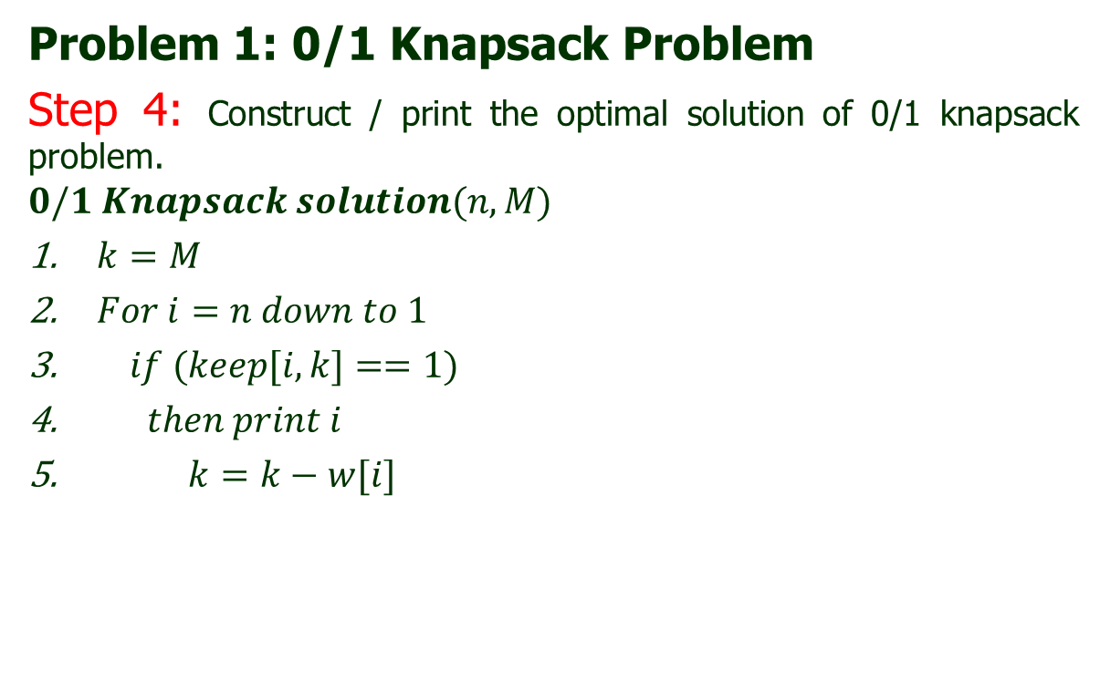
Dynamic Programming
Problem 1: 0/1 Knapsack Problem
Step 4: Construct / print the optimal solution of 0/1 knapsack problem.
$$0/1 Knapsack solution(n,M)$$
$k=M$
$For i=n down to 1$
$if (keep[i,k]==1)$
$then print i$
$k=k−w[i]$

Slide 12
Dynamic Programming
Problem 1: 0/1 Knapsack Problem (Implementation)
Consider-
Knapsack weight capacity = w
Number of items each having some weight and value = n
0/1 knapsack problem is solved using dynamic programming in the following steps-
Step-01:
Draw a table say ‘c’ with (n+1) number of rows and (w+1) number of columns.
Fill all the boxes of 0th row and 0th column with zeroes as shown in figure
0 | 1 | 2 | 3 | ... | w
1 | 0 | 0 | 0 | ... | 0
2 | 0
3 | 0
…. | ….
…. | ….
n | 0

Slide 13
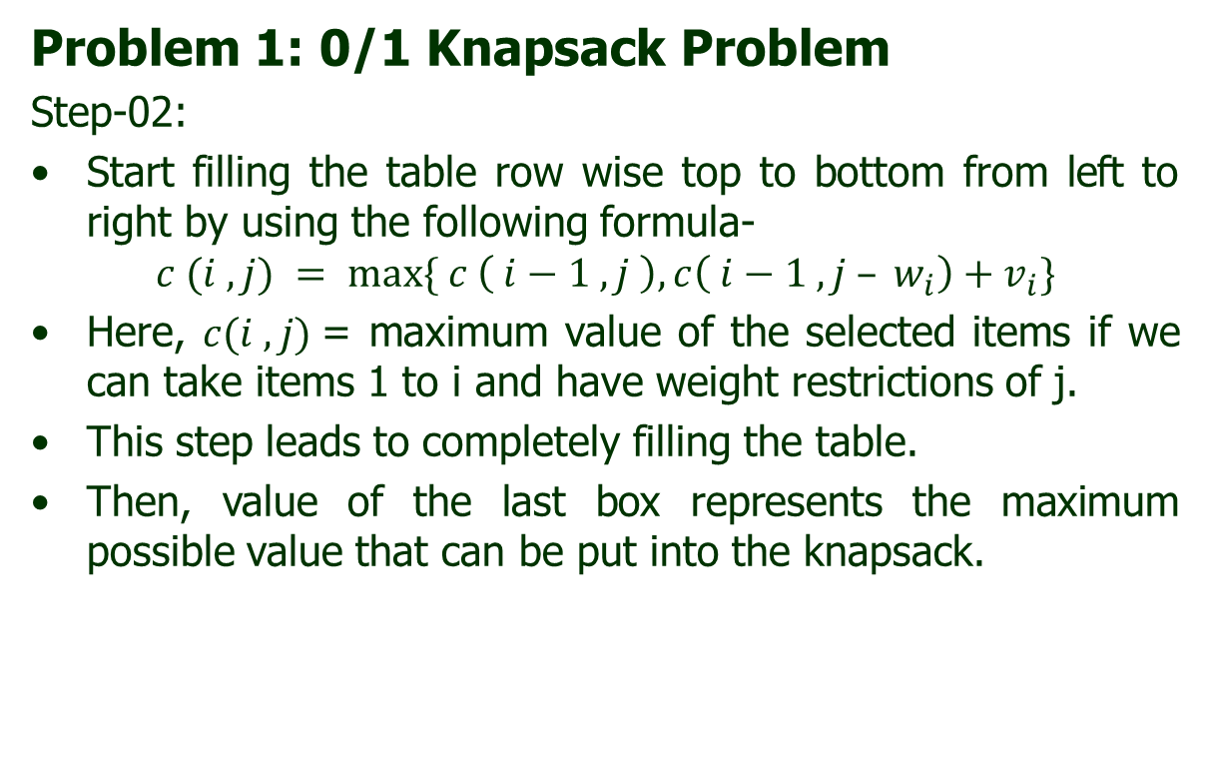
Dynamic Programming
Problem 1: 0/1 Knapsack Problem
Step-02:
Start filling the table row wise top to bottom from left to right by using the following formula-
$$c (i , j) = max⁡\{ c \left( i−1 , j \right), c\left( i−1 , j – w_{i}\right)+v_{i}\}$$
Here, $c(i , j)$= maximum value of the selected items if we can take items 1 to i and have weight restrictions of j.
This step leads to completely filling the table.
Then, value of the last box represents the maximum possible value that can be put into the knapsack.

Slide 14
Dynamic Programming
Problem 1: 0/1 Knapsack Problem
Step-03:
To identify the items that must be put into the knapsack to obtain that maximum profit, Consider the last column of the table.
Start scanning the entries from bottom to top.
On encountering an entry whose value is not same as the value stored in the entry immediately above it, mark the row label of that entry.
After all the entries are scanned, the marked labels represent the items that must be put into the knapsack.

Slide 15
Dynamic Programming
Problem 1: 0/1 Knapsack Problem
Example 1: For the given set of items and knapsack capacity of 8 kg, find the optimal solution for the 0/1 knapsack problem making use of dynamic programming approach.
Item | Weight | Profit
1 | 2 | 1
2 | 3 | 2
3 | 4 | 5
4 | 5 | 6

Slide 16
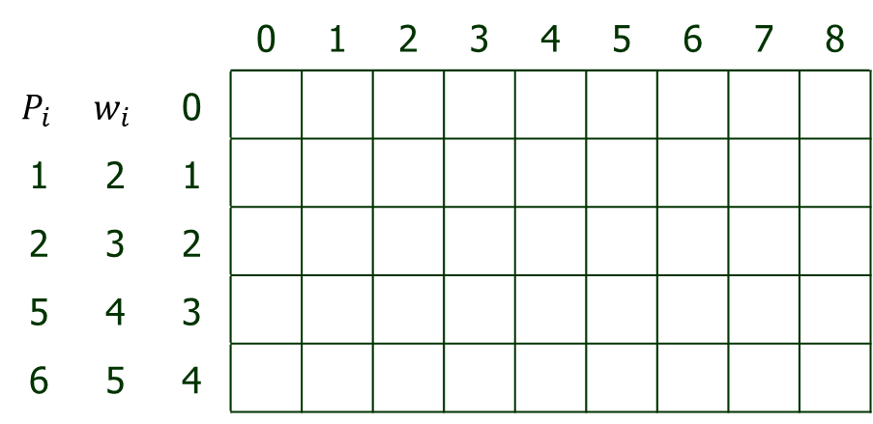
Dynamic Programming
Problem 1: 0/1 Knapsack Problem
Example 1: For the given set of items and knapsack capacity of 8 kg, find the optimal solution for the 0/1 knapsack problem making use of dynamic programming approach.
 |  |  | 0 | 1 | 2 | 3 | 4 | 5 | 6 | 7 | 8
$$P_{i}$$ | $$w_{i}$$ | 0
1 | 2 | 1
2 | 3 | 2
5 | 4 | 3
6 | 5 | 4

Slide 17
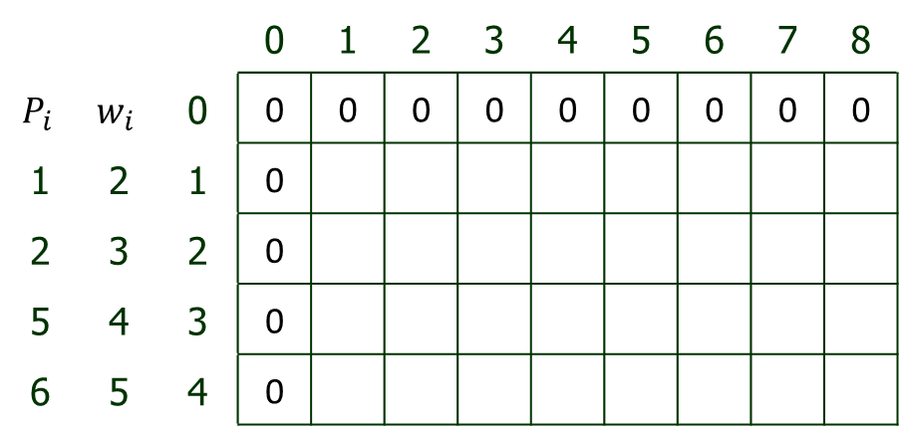
Dynamic Programming
Problem 1: 0/1 Knapsack Problem
Example 1: For the given set of items and knapsack capacity of 8 kg, find the optimal solution for the 0/1 knapsack problem making use of dynamic programming approach.
 |  |  | 0 | 1 | 2 | 3 | 4 | 5 | 6 | 7 | 8
$$P_{i}$$ | $$w_{i}$$ | 0 | 0 | 0 | 0 | 0 | 0 | 0 | 0 | 0 | 0
1 | 2 | 1 | 0
2 | 3 | 2 | 0
5 | 4 | 3 | 0
6 | 5 | 4 | 0

Slide 18
Dynamic Programming
Problem 1: 0/1 Knapsack Problem
Example 1: For the given set of items and knapsack capacity of 8 kg, find the optimal solution for the 0/1 knapsack problem making use of dynamic programming approach.
 |  |  | 0 | 1 | 2 | 3 | 4 | 5 | 6 | 7 | 8
$$P_{i}$$ | $$w_{i}$$ | 0 | 0 | 0 | 0 | 0 | 0 | 0 | 0 | 0 | 0
1 | 2 | 1 | 0
2 | 3 | 2 | 0
5 | 4 | 3 | 0
6 | 5 | 4 | 0

Slide 19
Dynamic Programming
Problem 1: 0/1 Knapsack Problem
Example 1: For the given set of items and knapsack capacity of 8 kg, find the optimal solution for the 0/1 knapsack problem making use of dynamic programming approach.
 |  |  | 0 | 1 | 2 | 3 | 4 | 5 | 6 | 7 | 8
$$P_{i}$$ | $$w_{i}$$ | 0 | 0 | 0 | 0 | 0 | 0 | 0 | 0 | 0 | 0
1 | 2 | 1 | 0
2 | 3 | 2 | 0
5 | 4 | 3 | 0
6 | 5 | 4 | 0

Slide 20

Dynamic Programming
Problem 1: 0/1 Knapsack Problem
Example 1: For the given set of items and knapsack capacity of 8 kg, find the optimal solution for the 0/1 knapsack problem making use of dynamic programming approach.
As maximum weight available is 2
 |  |  | 0 | 1 | 2 | 3 | 4 | 5 | 6 | 7 | 8
$$P_{i}$$ | $$w_{i}$$ | 0 | 0 | 0 | 0 | 0 | 0 | 0 | 0 | 0 | 0
1 | 2 | 1 | 0 |  | 1
2 | 3 | 2 | 0
5 | 4 | 3 | 0
6 | 5 | 4 | 0

Slide 21
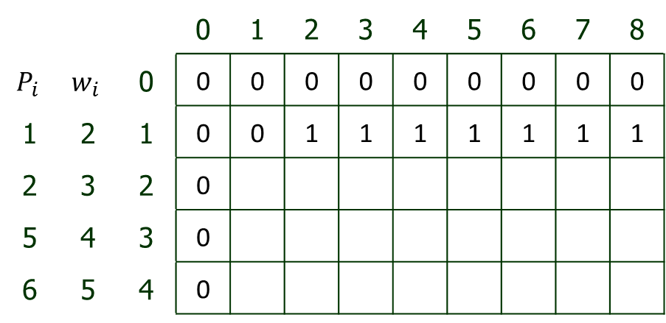
Dynamic Programming
Problem 1: 0/1 Knapsack Problem
Example 1: For the given set of items and knapsack capacity of 8 kg, find the optimal solution for the 0/1 knapsack problem making use of dynamic programming approach.
As maximum weight available is 2
 |  |  | 0 | 1 | 2 | 3 | 4 | 5 | 6 | 7 | 8
$$P_{i}$$ | $$w_{i}$$ | 0 | 0 | 0 | 0 | 0 | 0 | 0 | 0 | 0 | 0
1 | 2 | 1 | 0 | 0 | 1 | 1 | 1 | 1 | 1 | 1 | 1
2 | 3 | 2 | 0
5 | 4 | 3 | 0
6 | 5 | 4 | 0

Slide 22
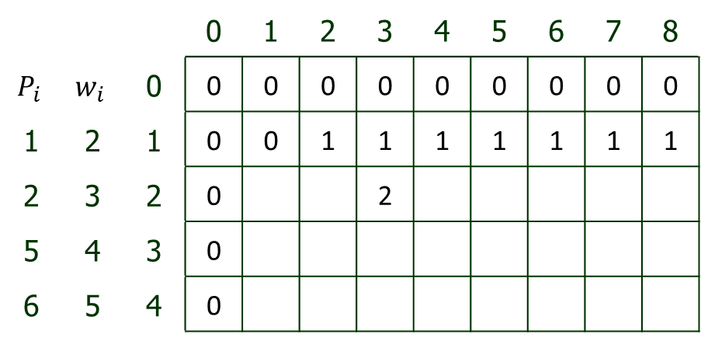
Dynamic Programming
Problem 1: 0/1 Knapsack Problem
Example 1: For the given set of items and knapsack capacity of 8 kg, find the optimal solution for the 0/1 knapsack problem making use of dynamic programming approach.
As maximum weight available is 2
 |  |  | 0 | 1 | 2 | 3 | 4 | 5 | 6 | 7 | 8
$$P_{i}$$ | $$w_{i}$$ | 0 | 0 | 0 | 0 | 0 | 0 | 0 | 0 | 0 | 0
1 | 2 | 1 | 0 | 0 | 1 | 1 | 1 | 1 | 1 | 1 | 1
2 | 3 | 2 | 0 |  |  | 2
5 | 4 | 3 | 0
6 | 5 | 4 | 0

Slide 23
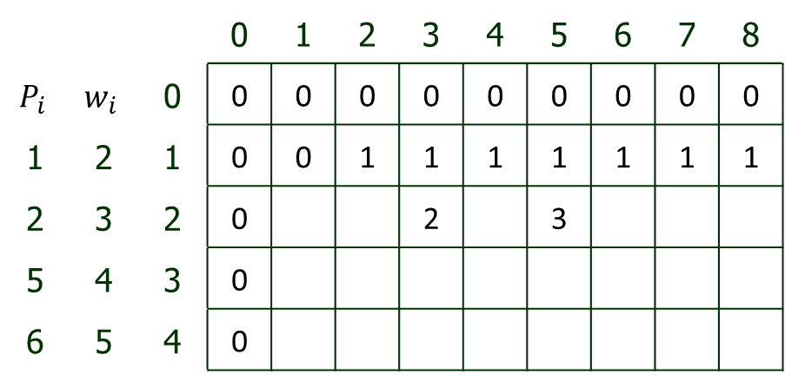
Dynamic Programming
Problem 1: 0/1 Knapsack Problem
Example 1: For the given set of items and knapsack capacity of 8 kg, find the optimal solution for the 0/1 knapsack problem making use of dynamic programming approach.
As maximum weight available is 2
 |  |  | 0 | 1 | 2 | 3 | 4 | 5 | 6 | 7 | 8
$$P_{i}$$ | $$w_{i}$$ | 0 | 0 | 0 | 0 | 0 | 0 | 0 | 0 | 0 | 0
1 | 2 | 1 | 0 | 0 | 1 | 1 | 1 | 1 | 1 | 1 | 1
2 | 3 | 2 | 0 |  |  | 2 |  | 3
5 | 4 | 3 | 0
6 | 5 | 4 | 0

Slide 24
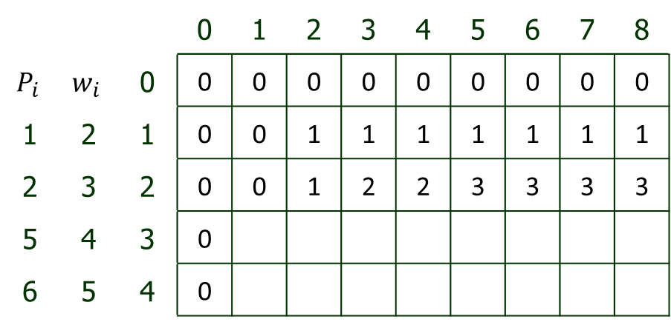
Dynamic Programming
Problem 1: 0/1 Knapsack Problem
Example 1: For the given set of items and knapsack capacity of 8 kg, find the optimal solution for the 0/1 knapsack problem making use of dynamic programming approach.
As two possible weight are available (i.e. 3 and 5)
 |  |  | 0 | 1 | 2 | 3 | 4 | 5 | 6 | 7 | 8
$$P_{i}$$ | $$w_{i}$$ | 0 | 0 | 0 | 0 | 0 | 0 | 0 | 0 | 0 | 0
1 | 2 | 1 | 0 | 0 | 1 | 1 | 1 | 1 | 1 | 1 | 1
2 | 3 | 2 | 0 | 0 | 1 | 2 | 2 | 3 | 3 | 3 | 3
5 | 4 | 3 | 0
6 | 5 | 4 | 0

Slide 25
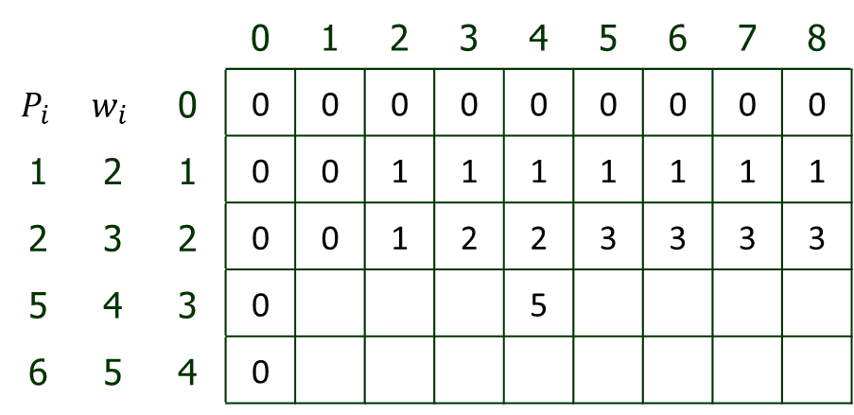
Dynamic Programming
Problem 1: 0/1 Knapsack Problem
Example 1: For the given set of items and knapsack capacity of 8 kg, find the optimal solution for the 0/1 knapsack problem making use of dynamic programming approach.
As maximum weight is available is : 4
 |  |  | 0 | 1 | 2 | 3 | 4 | 5 | 6 | 7 | 8
$$P_{i}$$ | $$w_{i}$$ | 0 | 0 | 0 | 0 | 0 | 0 | 0 | 0 | 0 | 0
1 | 2 | 1 | 0 | 0 | 1 | 1 | 1 | 1 | 1 | 1 | 1
2 | 3 | 2 | 0 | 0 | 1 | 2 | 2 | 3 | 3 | 3 | 3
5 | 4 | 3 | 0 |  |  |  | 5
6 | 5 | 4 | 0

Slide 26
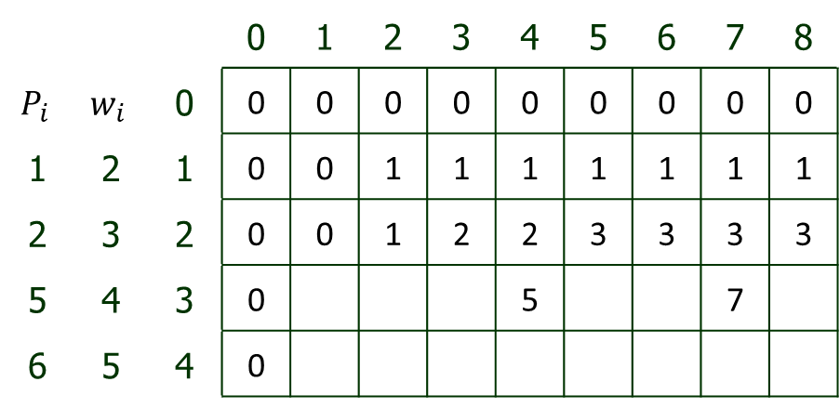
Dynamic Programming
Problem 1: 0/1 Knapsack Problem
Example 1: For the given set of items and knapsack capacity of 8 kg, find the optimal solution for the 0/1 knapsack problem making use of dynamic programming approach.
As maximum weight is available is : 7
 |  |  | 0 | 1 | 2 | 3 | 4 | 5 | 6 | 7 | 8
$$P_{i}$$ | $$w_{i}$$ | 0 | 0 | 0 | 0 | 0 | 0 | 0 | 0 | 0 | 0
1 | 2 | 1 | 0 | 0 | 1 | 1 | 1 | 1 | 1 | 1 | 1
2 | 3 | 2 | 0 | 0 | 1 | 2 | 2 | 3 | 3 | 3 | 3
5 | 4 | 3 | 0 |  |  |  | 5 |  |  | 7
6 | 5 | 4 | 0

Slide 27
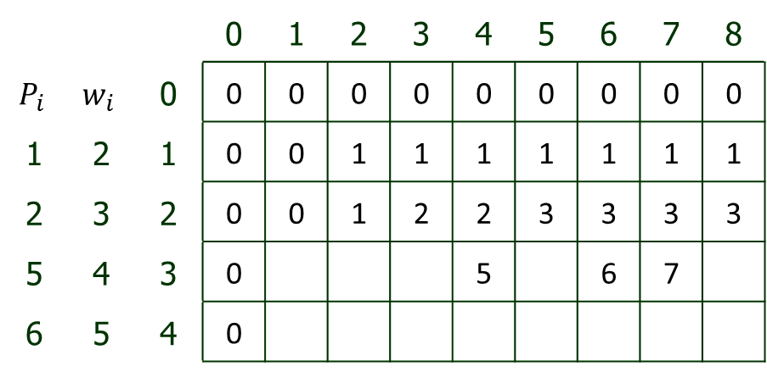
Dynamic Programming
Problem 1: 0/1 Knapsack Problem
Example 1: For the given set of items and knapsack capacity of 8 kg, find the optimal solution for the 0/1 knapsack problem making use of dynamic programming approach.
As maximum weight is available is : 6
 |  |  | 0 | 1 | 2 | 3 | 4 | 5 | 6 | 7 | 8
$$P_{i}$$ | $$w_{i}$$ | 0 | 0 | 0 | 0 | 0 | 0 | 0 | 0 | 0 | 0
1 | 2 | 1 | 0 | 0 | 1 | 1 | 1 | 1 | 1 | 1 | 1
2 | 3 | 2 | 0 | 0 | 1 | 2 | 2 | 3 | 3 | 3 | 3
5 | 4 | 3 | 0 |  |  |  | 5 |  | 6 | 7
6 | 5 | 4 | 0

Slide 28

Dynamic Programming
Problem 1: 0/1 Knapsack Problem
Example 1: For the given set of items and knapsack capacity of 8 kg, find the optimal solution for the 0/1 knapsack problem making use of dynamic programming approach.
As maximum weight is available is : 6
 |  |  | 0 | 1 | 2 | 3 | 4 | 5 | 6 | 7 | 8
$$P_{i}$$ | $$w_{i}$$ | 0 | 0 | 0 | 0 | 0 | 0 | 0 | 0 | 0 | 0
1 | 2 | 1 | 0 | 0 | 1 | 1 | 1 | 1 | 1 | 1 | 1
2 | 3 | 2 | 0 | 0 | 1 | 2 | 2 | 3 | 3 | 3 | 3
5 | 4 | 3 | 0 | 0 | 1 | 2 | 5 | 5 | 6 | 7 | 7
6 | 5 | 4 | 0

Slide 29
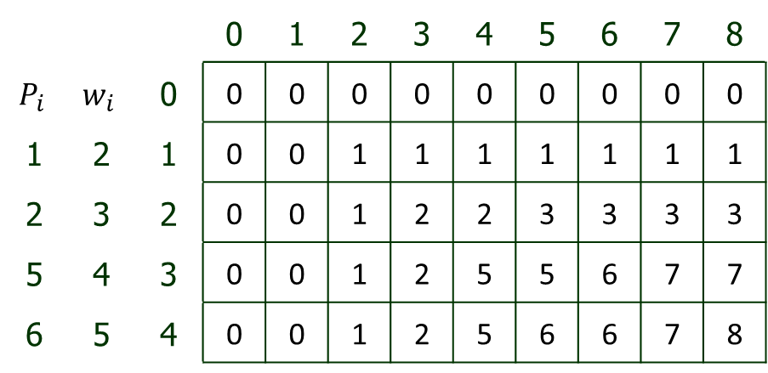
Dynamic Programming
Problem 1: 0/1 Knapsack Problem
Example 1: For the given set of items and knapsack capacity of 8 kg, find the optimal solution for the 0/1 knapsack problem making use of dynamic programming approach.
As maximum weight is available is : 5
 |  |  | 0 | 1 | 2 | 3 | 4 | 5 | 6 | 7 | 8
$$P_{i}$$ | $$w_{i}$$ | 0 | 0 | 0 | 0 | 0 | 0 | 0 | 0 | 0 | 0
1 | 2 | 1 | 0 | 0 | 1 | 1 | 1 | 1 | 1 | 1 | 1
2 | 3 | 2 | 0 | 0 | 1 | 2 | 2 | 3 | 3 | 3 | 3
5 | 4 | 3 | 0 | 0 | 1 | 2 | 5 | 5 | 6 | 7 | 7
6 | 5 | 4 | 0 | 0 | 1 | 2 | 5 | 6 | 6 | 7 | 8

Slide 30
Dynamic Programming
Problem 1: 0/1 Knapsack Problem
Example 1: For the given set of items and knapsack capacity of 8 kg, find the optimal solution for the 0/1 knapsack problem making use of dynamic programming approach.
As maximum weight is available is : 8
 |  |  | 0 | 1 | 2 | 3 | 4 | 5 | 6 | 7 | 8
$$P_{i}$$ | $$w_{i}$$ | 0 | 0 | 0 | 0 | 0 | 0 | 0 | 0 | 0 | 0
1 | 2 | 1 | 0 | 0 | 1 | 1 | 1 | 1 | 1 | 1 | 1
2 | 3 | 2 | 0 | 0 | 1 | 2 | 2 | 3 | 3 | 3 | 3
5 | 4 | 3 | 0 | 0 | 1 | 2 | 5 | 5 | 6 | 7 | 7
6 | 5 | 4 | 0 | 0 | 1 | 2 | 5 | 6 | 6 | 7 | 8

Slide 31

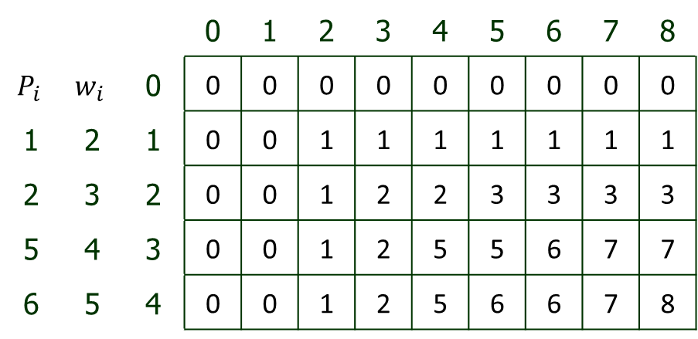
Dynamic Programming
Problem 1: 0/1 Knapsack Problem
Example 1: For the given set of items and knapsack capacity of 8 kg, find the optimal solution for the 0/1 knapsack problem making use of dynamic programming approach.
Apply the following formula for calculating the C Table
$c (i , j) = max⁡\{ c \left( i−1 , j \right), c\left( i−1 , j – w_{i}\right)+v_{i}\}$
 |  |  | 0 | 1 | 2 | 3 | 4 | 5 | 6 | 7 | 8
$$P_{i}$$ | $$w_{i}$$ | 0 | 0 | 0 | 0 | 0 | 0 | 0 | 0 | 0 | 0
1 | 2 | 1 | 0 | 0 | 1 | 1 | 1 | 1 | 1 | 1 | 1
2 | 3 | 2 | 0 | 0 | 1 | 2 | 2 | 3 | 3 | 3 | 3
5 | 4 | 3 | 0 | 0 | 1 | 2 | 5 | 5 | 6 | 7 | 7
6 | 5 | 4 | 0 | 0 | 1 | 2 | 5 | 6 | 6 | 7 | 8

Slide 32
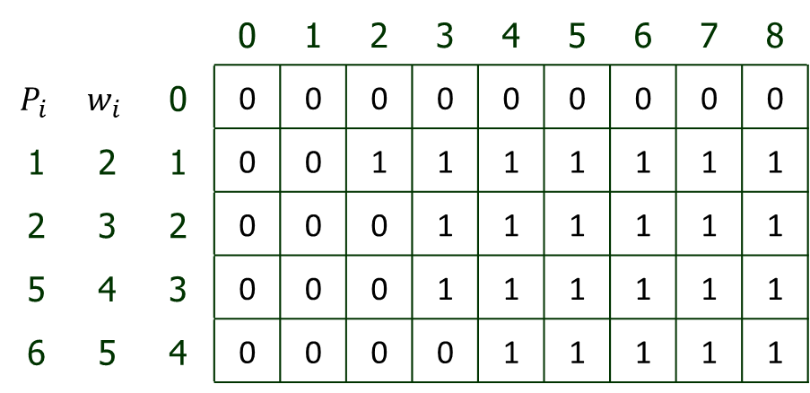
Dynamic Programming
Problem 1: 0/1 Knapsack Problem
Example 1: For the given set of items and knapsack capacity of 8 kg, find the optimal solution for the 0/1 knapsack problem making use of dynamic programming approach.
 |  |  | 0 | 1 | 2 | 3 | 4 | 5 | 6 | 7 | 8
$$P_{i}$$ | $$w_{i}$$ | 0 | 0 | 0 | 0 | 0 | 0 | 0 | 0 | 0 | 0
1 | 2 | 1 | 0 | 0 | 1 | 1 | 1 | 1 | 1 | 1 | 1
2 | 3 | 2 | 0 | 0 | 0 | 1 | 1 | 1 | 1 | 1 | 1
5 | 4 | 3 | 0 | 0 | 0 | 1 | 1 | 1 | 1 | 1 | 1
6 | 5 | 4 | 0 | 0 | 0 | 0 | 1 | 1 | 1 | 1 | 1
Keep array

Slide 33
Dynamic Programming
Problem 1: 0/1 Knapsack Problem
Example 1: For the given set of items and knapsack capacity of 8 kg, find the optimal solution for the 0/1 knapsack problem making use of dynamic programming approach.
 |  |  | 0 | 1 | 2 | 3 | 4 | 5 | 6 | 7 | 8
$$P_{i}$$ | $$w_{i}$$ | 0 | 0 | 0 | 0 | 0 | 0 | 0 | 0 | 0 | 0
1 | 2 | 1 | 0 | 0 | 1 | 1 | 1 | 1 | 1 | 1 | 1
2 | 3 | 2 | 0 | 0 | 0 | 1 | 1 | 1 | 1 | 1 | 1
5 | 4 | 3 | 0 | 0 | 0 | 1 | 1 | 1 | 1 | 1 | 1
6 | 5 | 4 | 0 | 0 | 0 | 0 | 1 | 1 | 1 | 1 | 1
Keep array

Slide 34
Dynamic Programming
Problem 1: 0/1 Knapsack Problem (Complexity)
Time complexity of 0 1 Knapsack problem is O(nM) .
where, n is the number of items and M is the capacity of knapsack.

Slide 35
Dynamic Programming
Problem 2: Floyd-Warshall Algorithm
The all pair shortest path problem is the problem of finding a path between two vertices or nodes in a graph such that the sum of the weights of its constituents edges is minimized.
This problem is also known as All pair shortest path problem.
Floyd-Warshall Algorithm is an example of dynamic programming approach.
The advantages of Floyd-Warshall Algorithm are:
  Easy to implement and extremely simple.

Slide 36
Dynamic Programming
Problem 2: Floyd-Warshall Algorithm (Requirements)
Graph must be weighted directed graph.
Edge weights can be positive or negative.
There should be no negative cycle.
  (A negative cycle is a cycle whose edges sum give a negative value)
This algorithm is best suited for dense graphs because, it’s complexity depends on the number of vertices in the given graph

Slide 37
Dynamic Programming
Problem 2: Floyd-Warshall Algorithm (Algorithm)
Graph must be weighted directed graph.
Edge weights can be positive or negative.
There should be no negative cycle.
  (A negative cycle is a cycle whose edges sum give a negative value)
This algorithm is best suited for dense graphs because, it’s complexity depends on the number of vertices in the given graph

Slide 38

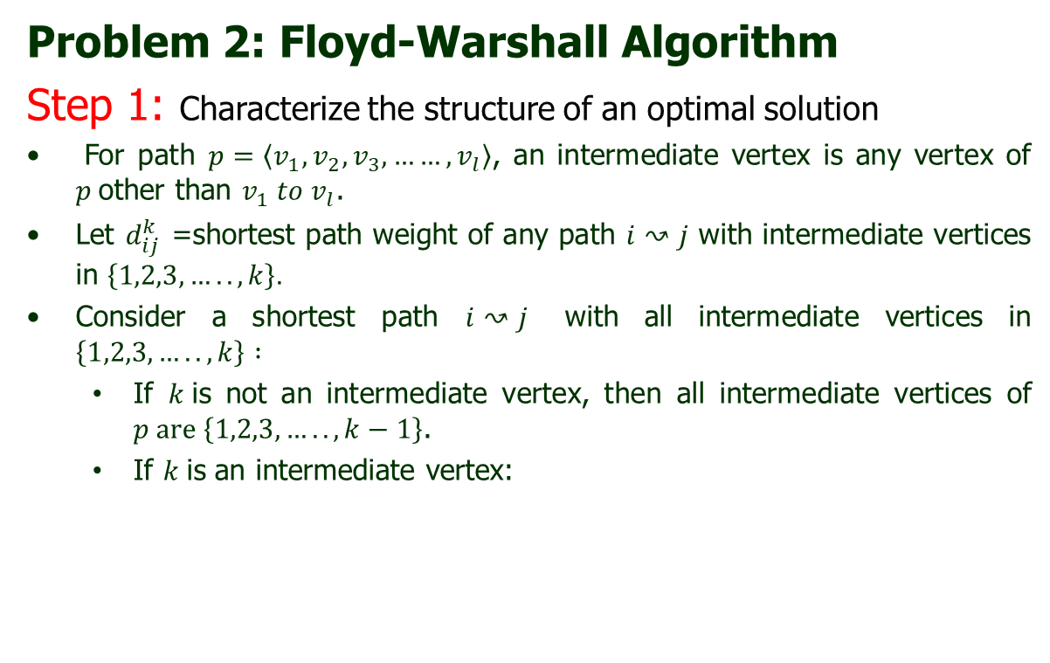





Dynamic Programming
Problem 2: Floyd-Warshall Algorithm
Step 1: Characterize the structure of an optimal solution
For path $p=\left\langle v_{1},v_{2},v_{3}, ……,v_{l}\right\rangle$, an intermediate vertex is any vertex of $p$other than $v_{1} to v_{l}$.
Let $d_{ij}^{k}$ =shortest path weight of any path $i↝j$ with intermediate vertices in $\left\{1,2,3,…..,k\right\}.$
Consider a shortest path $i↝j$ with all intermediate vertices in $\left\{1,2,3,…..,k\right\} :$
  If $k$is not an intermediate vertex, then all intermediate vertices of $p are \left\{1,2,3,…..,k−1\right\}$.
  If $k$is an intermediate vertex:
$$p_{1}$$
$$p_{2}$$
$$i$$
$$k$$
$$j$$
$$all intermediate vertices in$$
$$\left\{1,2,3,…..,k−1\right\}$$

Slide 39
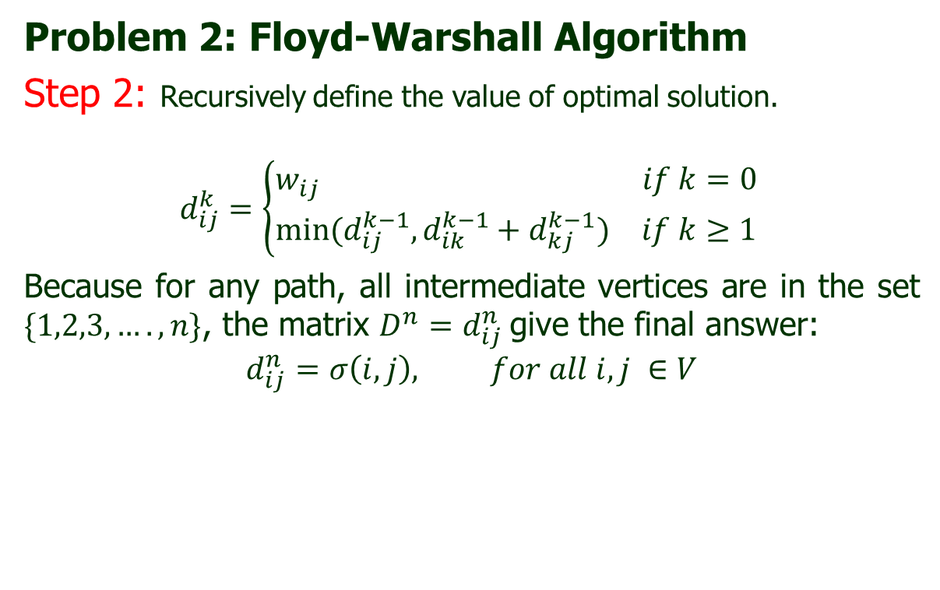
Dynamic Programming
Problem 2: Floyd-Warshall Algorithm
Step 2: Recursively define the value of optimal solution.
$$d_{ij}^{k}=\left\{\begin{aligned}\begin{matrix}w_{ij } & if k=0\end{matrix} \\ \begin{matrix}min⁡(d_{ij}^{k−1}, d_{ik}^{k−1}+d_{kj}^{k−1}) & if k≥1\end{matrix}\end{aligned}\right.$$
Because for any path, all intermediate vertices are in the set $\{1,2,3,….,n\}$, the matrix $D^{n}=d_{ij}^{n}$give the final answer:
$$d_{ij}^{n}=σ\left(i,j\right), for all i,j ∈V$$

Slide 40
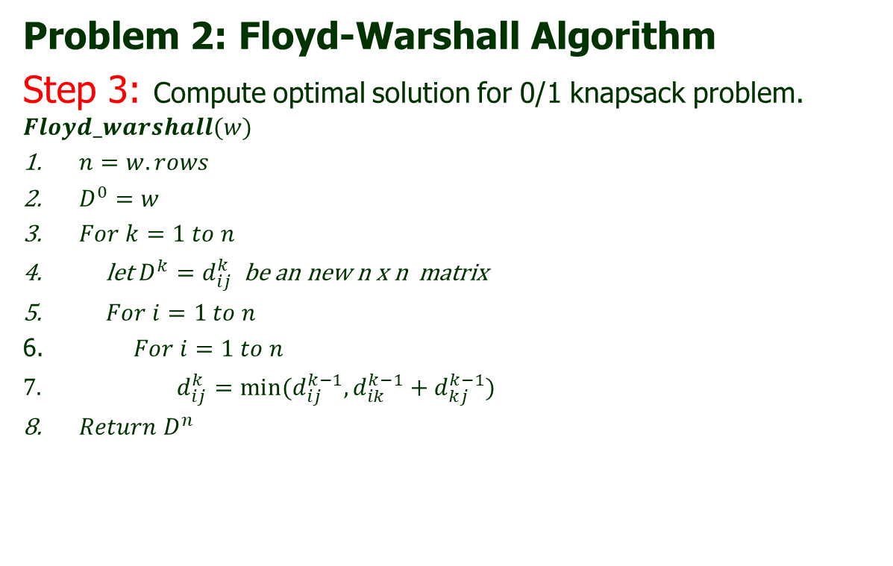
Dynamic Programming
Problem 2: Floyd-Warshall Algorithm
Step 3: Compute optimal solution for 0/1 knapsack problem.
$$Floyd_warshall(w)$$
$n=w.rows$
$D^{0}=w$
$For k=1 to n$
let $D^{k}=d_{ij}^{k}$ be an new n x n matrix
$For i=1 to n$
$For i=1 to n$
$d_{ij}^{k}=min⁡(d_{ij}^{k−1}, d_{ik}^{k−1}+d_{kj}^{k−1})$
$Return D^{n}$

Slide 41
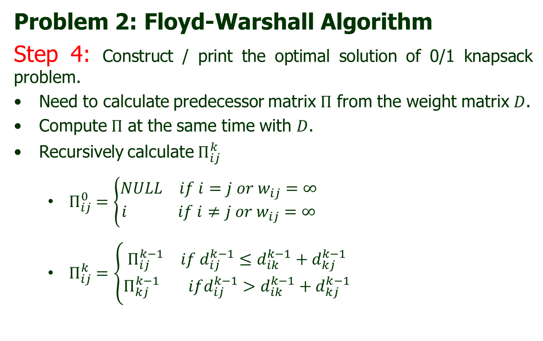
Dynamic Programming
Problem 2: Floyd-Warshall Algorithm
Step 4: Construct / print the optimal solution of 0/1 knapsack problem.
Need to calculate predecessor matrix $Π$ from the weight matrix $D$.
Compute $Π$ at the same time with $D$.
Recursively calculate $Π_{ij}^{k}$
  $Π_{ij}^{0}=\left\{\begin{aligned}\begin{matrix}NULL & if i=j or w_{ij}=∞\end{matrix} \\ \begin{matrix}i & if i≠j or w_{ij}=∞\end{matrix}\end{aligned}\right.$
  $Π_{ij}^{k}=\left\{\begin{aligned}\begin{matrix}Π_{ij}^{k−1} & if d_{ij}^{k−1}≤d_{ik}^{k−1}+d_{kj}^{k−1}\end{matrix} \\ \begin{matrix}Π_{kj}^{k−1} & ifd_{ij}^{k−1}>d_{ik}^{k−1}+d_{kj}^{k−1}\end{matrix}\end{aligned}\right.$

Slide 42
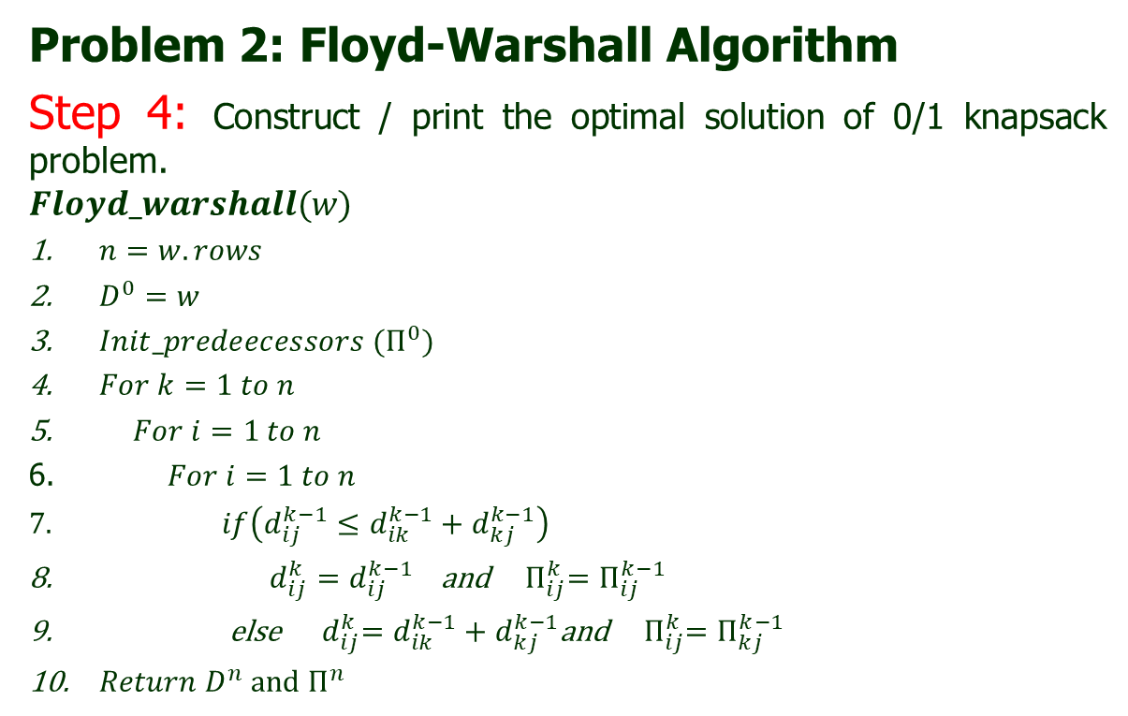
Dynamic Programming
Problem 2: Floyd-Warshall Algorithm
Step 4: Construct / print the optimal solution of 0/1 knapsack problem.
$$Floyd_warshall(w)$$
$n=w.rows$
$D^{0}=w$
$Init_predeecessors (Π^{0})$
$For k=1 to n$
$For i=1 to n$
$For i=1 to n$
$if\left(d_{ij}^{k−1}≤d_{ik}^{k−1}+d_{kj}^{k−1}\right)$
$d_{ij}^{k}=d_{ij}^{k−1}$ and ${ Π}_{ij}^{k}=Π_{ij}^{k−1}$
else ${ d}_{ij}^{k}=d_{ik}^{k−1}+d_{kj}^{k−1}$and ${ Π}_{ij}^{k}=Π_{kj}^{k−1}$
$Return D^{n} and Π^{n}$

Slide 43
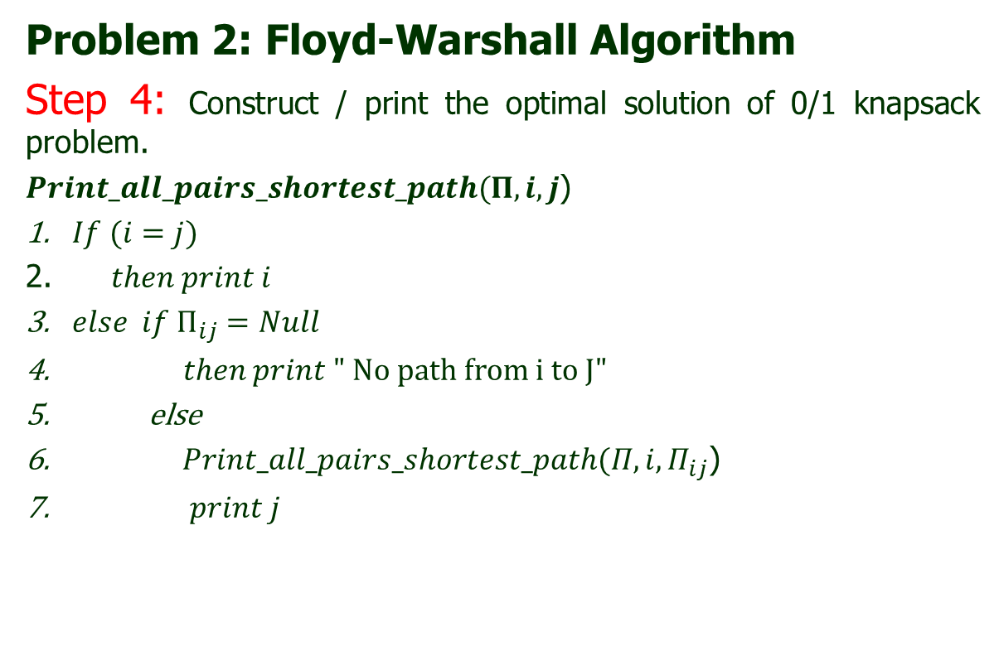
Dynamic Programming
Problem 2: Floyd-Warshall Algorithm
Step 4: Construct / print the optimal solution of 0/1 knapsack problem.
$Print_all_pairs_shortest_path(Π,i,j$)
$If (i=j)$
$then print i$
$else if Π_{ij}=Null$
$then print " No path from i to J"$
else
$Print_all_pairs_shortest_path(Π,i,Π_{ij}$)
$print j$

Slide 44
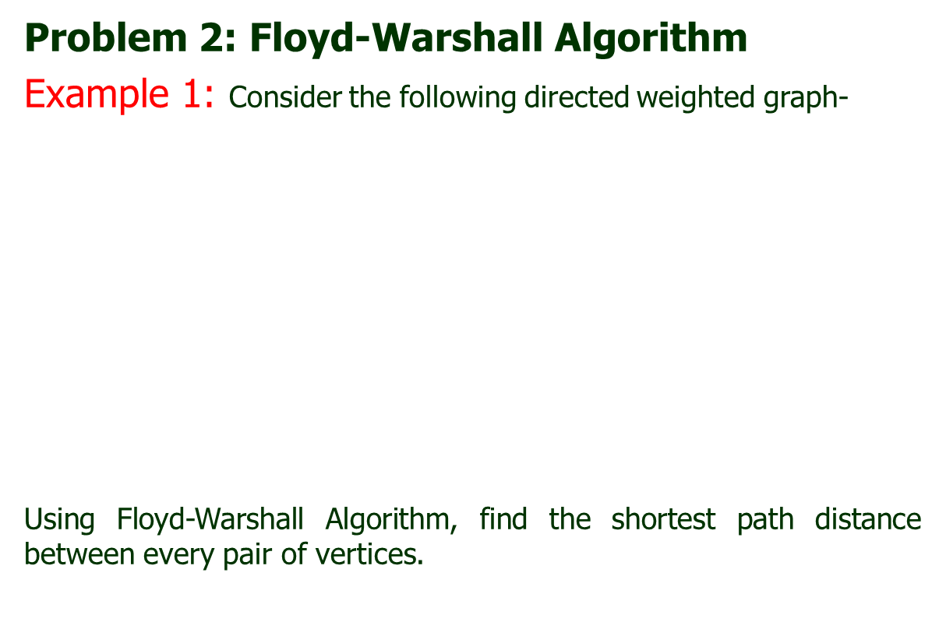
Dynamic Programming
Problem 2: Floyd-Warshall Algorithm
Example 1: Consider the following directed weighted graph-
Using Floyd-Warshall Algorithm, find the shortest path distance between every pair of vertices.
3
2
4
1
8
3
2
1
-4
-5
7
5
4
6

Slide 45
Dynamic Programming
Problem 2: Floyd-Warshall Algorithm
Example 1: Consider the following directed weighted graph-
Solution:
Step-01:
Remove all the self loops and parallel edges (keeping the lowest weight edge) from the graph.
In the given graph, there are neither self edges nor parallel edges.

Slide 46
Dynamic Programming
Problem 2: Floyd-Warshall Algorithm
Example 1: Consider the following directed weighted graph-
Solution:
Step-02:
Write the initial distance matrix.
It represents the distance between every pair of vertices in the form of given weights.
For diagonal elements (representing self-loops), distance value = 0.
For vertices having a direct edge between them, distance value = weight of that edge.
For vertices having no direct edge between them, distance value = ∞.

Slide 47
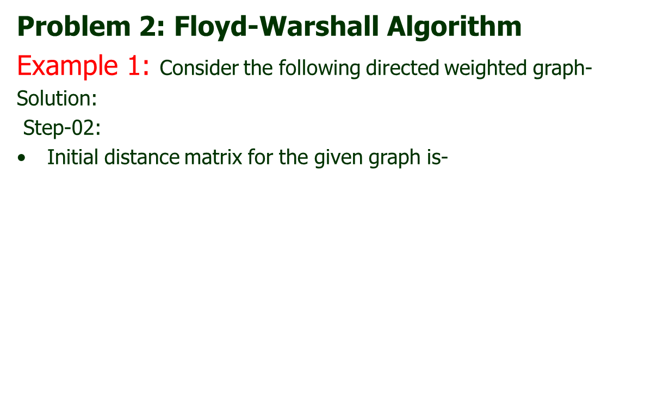

Dynamic Programming
Problem 2: Floyd-Warshall Algorithm
Example 1: Consider the following directed weighted graph-
Solution:
Step-02:
Initial distance matrix for the given graph is-
2
 | 1 | 2 | 3 | 4 | 5
1 | 0 | 3 | 8 | ∞ | -4
2 | ∞ | 0 | ∞ | 1 | 7
3 | ∞ | 4 | 0 | ∞ | ∞
4 | 2 | ∞ | -5 | 0 | ∞
5 | ∞ | ∞ | ∞ | 6 | 0
3
4
1
8
3
2
$$D^{0}=$$
1
-4
-5
7
5
4
6

Slide 48
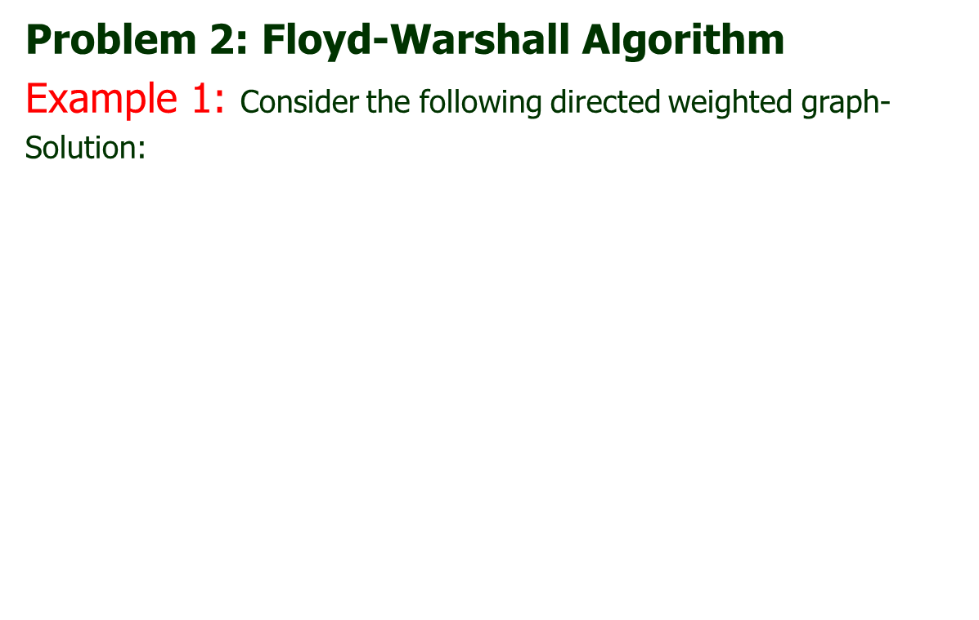


Dynamic Programming
Problem 2: Floyd-Warshall Algorithm
Example 1: Consider the following directed weighted graph-
Solution:
3
2
4
1
8
3
2
1
-5
-4
7
 | 1 | 2 | 3 | 4 | 5
1 | 0 | 3 | 8 | ∞ | -4
2 | ∞ | 0 | ∞ | 1 | 7
3 | ∞ | 4 | 0 | ∞ | ∞
4 | 2 | ∞ | -5 | 0 | ∞
5 | ∞ | ∞ | ∞ | 6 | 0
5
4
 | 1 | 2 | 3 | 4 | 5
1 | N | 1 | 1 | N | 1
2 | N | N | N | 2 | 2
3 | N | 3 | N | N | N
4 | 4 | N | 4 | N | N
5 | N | N | N | 5 | 0
6
$$D^{0}=$$
$$Π^{0}=$$

Slide 49
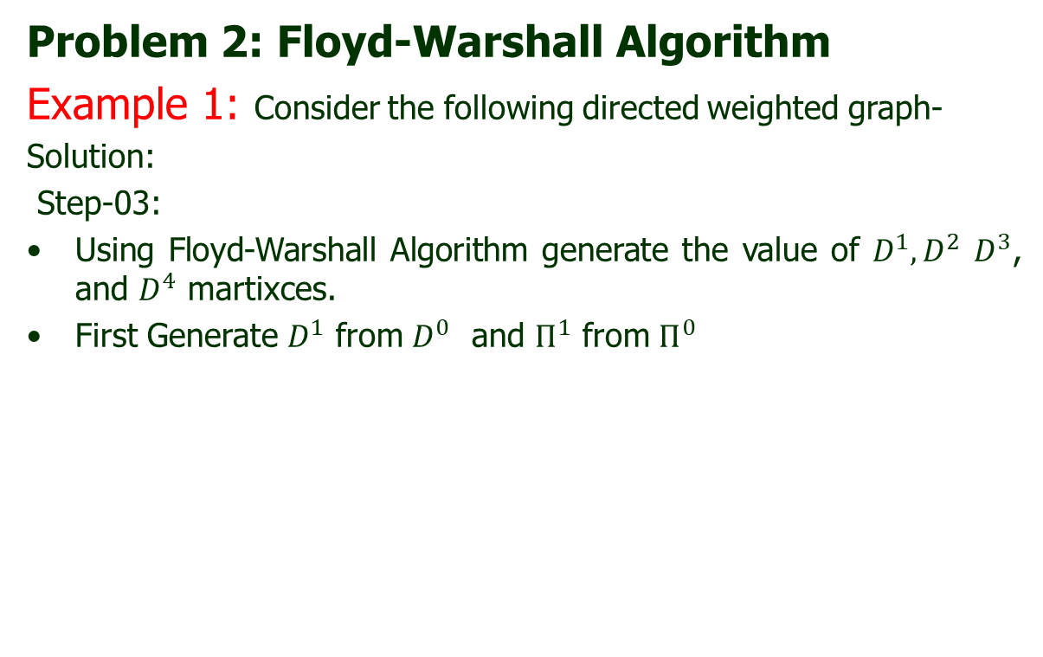
Dynamic Programming
Problem 2: Floyd-Warshall Algorithm
Example 1: Consider the following directed weighted graph-
Solution:
Step-03:
Using Floyd-Warshall Algorithm generate the value of $D^{1}, D^{2}$ $D^{3}$, and $D^{4}$ martixces.
First Generate $D^{1}$ from $D^{0}$ and $Π^{1}$ from $Π^{0}$

Slide 50
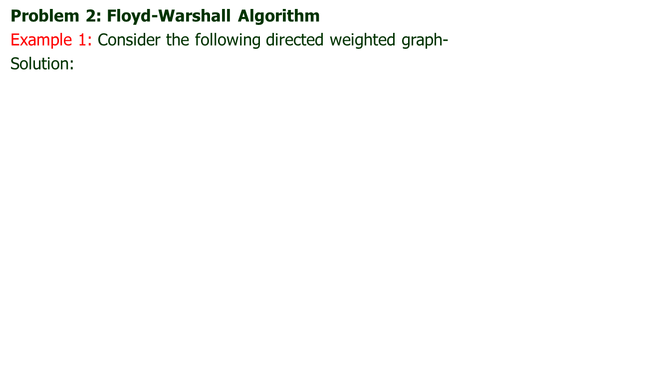




Dynamic Programming
Problem 2: Floyd-Warshall Algorithm
Example 1: Consider the following directed weighted graph-
Solution:
 | 1 | 2 | 3 | 4 | 5
1 | 0 | 3 | 8 | ∞ | -4
2 | ∞ | 0 | ∞ | 1 | 7
3 | ∞ | 4 | 0 | ∞ | ∞
4 | 2 | ∞ | -5 | 0 | ∞
5 | ∞ | ∞ | ∞ | 6 | 0
 | 1 | 2 | 3 | 4 | 5
1 | N | 1 | 1 | N | 1
2 | N | N | N | 2 | 2
3 | N | 3 | N | N | N
4 | 4 | N | 4 | N | N
5 | N | N | N | 5 | 0
$$D^{0}=$$
$$Π^{0}=$$
3
2
4
1
8
3
2
1
-5
 | 1 | 2 | 3 | 4 | 5
1 | 0 | 3 | 8 | ∞ | -4
2 | ∞
3 | ∞
4 | 2
5 | ∞
-4
7
 | 1 | 2 | 3 | 4 | 5
1 | N | 1 | 1 | N | 1
2 | N
3 | N
4 | 4
5 | N
4
6
5
$$D^{1}=$$
$$Π^{1}=$$

Slide 51
Dynamic Programming
Problem 2: Floyd-Warshall Algorithm
Example 1: Consider the following directed weighted graph-
Solution:
 | 1 | 2 | 3 | 4 | 5
1 | 0 | 3 | 8 | ∞ | -4
2 | ∞ | 0 | ∞ | 1 | 7
3 | ∞ | 4 | 0 | ∞ | ∞
4 | 2 | ∞ | -5 | 0 | ∞
5 | ∞ | ∞ | ∞ | 6 | 0
 | 1 | 2 | 3 | 4 | 5
1 | N | 1 | 1 | N | 1
2 | N | N | N | 2 | 2
3 | N | 3 | N | N | N
4 | 4 | N | 4 | N | N
5 | N | N | N | 5 | 0
$$D^{0}=$$
$$Π^{0}=$$
3
2
4
1
8
3
2
1
-5
 | 1 | 2 | 3 | 4 | 5
1 | 0 | 3 | 8 | ∞ | -4
2 | ∞ | 0 | ∞ | 1 | 7
3 | ∞ | 4 | 0 | ∞ | ∞
4 | 2
5 | ∞ | ∞ | ∞ | 6 | 0
-4
7
 | 1 | 2 | 3 | 4 | 5
1 | N | 1 | 1 | N | 1
2 | N | N | N | 2 | 2
3 | N | 3 | N | N | N
4 | 4
5 | N | N | N | 5 | 0
5
6
4
$$D^{1}=$$
$$Π^{1}=$$

Slide 52
Dynamic Programming
Problem 2: Floyd-Warshall Algorithm
Example 1: Consider the following directed weighted graph-
Solution:
 | 1 | 2 | 3 | 4 | 5
1 | 0 | 3 | 8 | ∞ | -4
2 | ∞ | 0 | ∞ | 1 | 7
3 | ∞ | 4 | 0 | ∞ | ∞
4 | 2 | ∞ | -5 | 0 | ∞
5 | ∞ | ∞ | ∞ | 6 | 0
 | 1 | 2 | 3 | 4 | 5
1 | N | 1 | 1 | N | 1
2 | N | N | N | 2 | 2
3 | N | 3 | N | N | N
4 | 4 | N | 4 | N | N
5 | N | N | N | 5 | 0
$$D^{0}=$$
$$Π^{0}=$$
3
2
4
1
8
3
2
1
-5
 | 1 | 2 | 3 | 4 | 5
1 | 0 | 3 | 8 | ∞ | -4
2 | ∞ | 0 | ∞ | 1 | 7
3 | ∞ | 4 | 0 | ∞ | ∞
4 | 2 |  |  | 0
5 | ∞ | ∞ | ∞ | 6 | 0
-4
7
 | 1 | 2 | 3 | 4 | 5
1 | N | 1 | 1 | N | 1
2 | N | N | N | 2 | 2
3 | N | 3 | N | N | N
4 | 4 |  |  | N
5 | N | N | N | 5 | 0
5
6
4
$$D^{1}=$$
$$Π^{1}=$$

Slide 53
Dynamic Programming
Problem 2: Floyd-Warshall Algorithm
Example 1: Consider the following directed weighted graph-
Solution:
 | 1 | 2 | 3 | 4 | 5
1 | 0 | 3 | 8 | ∞ | -4
2 | ∞ | 0 | ∞ | 1 | 7
3 | ∞ | 4 | 0 | ∞ | ∞
4 | 2 | ∞ | -5 | 0 | ∞
5 | ∞ | ∞ | ∞ | 6 | 0
 | 1 | 2 | 3 | 4 | 5
1 | N | 1 | 1 | N | 1
2 | N | N | N | 2 | 2
3 | N | 3 | N | N | N
4 | 4 | N | 4 | N | N
5 | N | N | N | 5 | 0
$$D^{0}=$$
$$Π^{0}=$$
3
2
4
1
8
3
2
1
-5
 | 1 | 2 | 3 | 4 | 5
1 | 0 | 3 | 8 | ∞ | -4
2 | ∞ | 0 | ∞ | 1 | 7
3 | ∞ | 4 | 0 | ∞ | ∞
4 | 2 | 5 |  | 0
5 | ∞ | ∞ | ∞ | 6 | 0
-4
7
 | 1 | 2 | 3 | 4 | 5
1 | N | 1 | 1 | N | 1
2 | N | N | N | 2 | 2
3 | N | 3 | N | N | N
4 | 4 | 1 |  | N
5 | N | N | N | 5 | 0
5
6
4
$$D^{1}=$$
$$Π^{1}=$$

Slide 54
Dynamic Programming
Problem 2: Floyd-Warshall Algorithm
Example 1: Consider the following directed weighted graph-
Solution:
 | 1 | 2 | 3 | 4 | 5
1 | 0 | 3 | 8 | ∞ | -4
2 | ∞ | 0 | ∞ | 1 | 7
3 | ∞ | 4 | 0 | ∞ | ∞
4 | 2 | ∞ | -5 | 0 | ∞
5 | ∞ | ∞ | ∞ | 6 | 0
 | 1 | 2 | 3 | 4 | 5
1 | N | 1 | 1 | N | 1
2 | N | N | N | 2 | 2
3 | N | 3 | N | N | N
4 | 4 | N | 4 | N | N
5 | N | N | N | 5 | 0
$$D^{0}=$$
$$Π^{0}=$$
3
2
4
1
8
3
2
1
-5
 | 1 | 2 | 3 | 4 | 5
1 | 0 | 3 | 8 | ∞ | -4
2 | ∞ | 0 | ∞ | 1 | 7
3 | ∞ | 4 | 0 | ∞ | ∞
4 | 2 | 5 | -5 | 0
5 | ∞ | ∞ | ∞ | 6 | 0
-4
7
 | 1 | 2 | 3 | 4 | 5
1 | N | 1 | 1 | N | 1
2 | N | N | N | 2 | 2
3 | N | 3 | N | N | N
4 | 4 | 1 | 4 | N
5 | N | N | N | 5 | 0
5
6
4
$$D^{1}=$$
$$Π^{1}=$$

Slide 55
Dynamic Programming
Problem 2: Floyd-Warshall Algorithm
Example 1: Consider the following directed weighted graph-
Solution:
 | 1 | 2 | 3 | 4 | 5
1 | 0 | 3 | 8 | ∞ | -4
2 | ∞ | 0 | ∞ | 1 | 7
3 | ∞ | 4 | 0 | ∞ | ∞
4 | 2 | ∞ | -5 | 0 | ∞
5 | ∞ | ∞ | ∞ | 6 | 0
 | 1 | 2 | 3 | 4 | 5
1 | N | 1 | 1 | N | 1
2 | N | N | N | 2 | 2
3 | N | 3 | N | N | N
4 | 4 | N | 4 | N | N
5 | N | N | N | 5 | 0
$$D^{0}=$$
$$Π^{0}=$$
3
2
4
1
8
3
2
1
-5
 | 1 | 2 | 3 | 4 | 5
1 | 0 | 3 | 8 | ∞ | -4
2 | ∞ | 0 | ∞ | 1 | 7
3 | ∞ | 4 | 0 | ∞ | ∞
4 | 2 | 5 | -5 | 0 | -2
5 | ∞ | ∞ | ∞ | 6 | 0
-4
7
 | 1 | 2 | 3 | 4 | 5
1 | N | 1 | 1 | N | 1
2 | N | N | N | 2 | 2
3 | N | 3 | N | N | N
4 | 4 | 1 | 4 | N | 1
5 | N | N | N | 5 | 0
5
6
4
$$D^{1}=$$
$$Π^{1}=$$

Slide 56




Dynamic Programming
Problem 2: Floyd-Warshall Algorithm
Example 1: Consider the following directed weighted graph-
Solution:
 | 1 | 2 | 3 | 4 | 5
1 | 0 | 3 | 8 | ∞ | -4
2 | ∞ | 0 | ∞ | 1 | 7
3 | ∞ | 4 | 0 | ∞ | ∞
4 | 2 | 5 | -5 | 0 | -2
5 | ∞ | ∞ | ∞ | 6 | 0
 | 1 | 2 | 3 | 4 | 5
1 | N | 1 | 1 | N | 1
2 | N | N | N | 2 | 2
3 | N | 3 | N | N | N
4 | 4 | 1 | 4 | N | 1
5 | N | N | N | 5 | 0
$$D^{1}=$$
$$Π^{1}=$$
3
2
4
1
8
3
2
1
-5
 | 1 | 2 | 3 | 4 | 5
1 |  | 3
2 | ∞ | 0 | ∞ | 1 | 7
3 |  | 4
4 |  | 5
5 |  | ∞
-4
7
 | 1 | 2 | 3 | 4 | 5
1 |  | 1
2 | N | N | N | 2 | 2
3 |  | 3
4 |  | 1
5 |  | N
5
6
4
$$D^{2}=$$
$$Π^{2}=$$

Slide 57
Dynamic Programming
Problem 2: Floyd-Warshall Algorithm
Example 1: Consider the following directed weighted graph-
Solution:
 | 1 | 2 | 3 | 4 | 5
1 | 0 | 3 | 8 | ∞ | -4
2 | ∞ | 0 | ∞ | 1 | 7
3 | ∞ | 4 | 0 | ∞ | ∞
4 | 2 | 5 | -5 | 0 | -2
5 | ∞ | ∞ | ∞ | 6 | 0
 | 1 | 2 | 3 | 4 | 5
1 | N | 1 | 1 | N | 1
2 | N | N | N | 2 | 2
3 | N | 3 | N | N | N
4 | 4 | 1 | 4 | N | 1
5 | N | N | N | 5 | 0
$$D^{1}=$$
$$Π^{1}=$$
3
2
4
1
8
3
2
1
-5
 | 1 | 2 | 3 | 4 | 5
1 | 0 | 3
2 | ∞ | 0 | ∞ | 1 | 7
3 |  | 4 | 0
4 |  | 5 |  | 0
5 |  | ∞ |  |  | 0
-4
7
 | 1 | 2 | 3 | 4 | 5
1 | N | 1
2 | N | N | N | 2 | 2
3 |  | 3 | N
4 |  | 1 |  | N
5 |  | N |  |  | N
5
6
4
$$D^{2}=$$
$$Π^{2}=$$

Slide 58
Dynamic Programming
Problem 2: Floyd-Warshall Algorithm
Example 1: Consider the following directed weighted graph-
Solution:
 | 1 | 2 | 3 | 4 | 5
1 | 0 | 3 | 8 | ∞ | -4
2 | ∞ | 0 | ∞ | 1 | 7
3 | ∞ | 4 | 0 | ∞ | ∞
4 | 2 | 5 | -5 | 0 | -2
5 | ∞ | ∞ | ∞ | 6 | 0
 | 1 | 2 | 3 | 4 | 5
1 | N | 1 | 1 | N | 1
2 | N | N | N | 2 | 2
3 | N | 3 | N | N | N
4 | 4 | 1 | 4 | N | 1
5 | N | N | N | 5 | 0
$$D^{1}=$$
$$Π^{1}=$$
3
2
4
1
8
3
2
1
-5
 | 1 | 2 | 3 | 4 | 5
1 | 0 | 3 | 8
2 | ∞ | 0 | ∞ | 1 | 7
3 | ∞ | 4 | 0
4 | 2 | 5 | -5 | 0
5 | ∞ | ∞ | ∞ | 6 | 0
-4
7
 | 1 | 2 | 3 | 4 | 5
1 | N | 1 | 1
2 | N | N | N | 2 | 2
3 | N | 3 | N
4 | 4 | 1 | 4 | N
5 | N | N | N | 5 | N
5
6
4
$$D^{2}=$$
$$Π^{2}=$$

Slide 59
Dynamic Programming
Problem 2: Floyd-Warshall Algorithm
Example 1: Consider the following directed weighted graph-
Solution:
 | 1 | 2 | 3 | 4 | 5
1 | 0 | 3 | 8 | ∞ | -4
2 | ∞ | 0 | ∞ | 1 | 7
3 | ∞ | 4 | 0 | ∞ | ∞
4 | 2 | 5 | -5 | 0 | -2
5 | ∞ | ∞ | ∞ | 6 | 0
 | 1 | 2 | 3 | 4 | 5
1 | N | 1 | 1 | N | 1
2 | N | N | N | 2 | 2
3 | N | 3 | N | N | N
4 | 4 | 1 | 4 | N | 1
5 | N | N | N | 5 | 0
$$D^{1}=$$
$$Π^{1}=$$
3
2
4
1
8
3
2
1
-5
 | 1 | 2 | 3 | 4 | 5
1 | 0 | 3 | 8 | 4
2 | ∞ | 0 | ∞ | 1 | 7
3 | ∞ | 4 | 0
4 | 2 | 5 | -5 | 0
5 | ∞ | ∞ | ∞ | 6 | 0
-4
7
 | 1 | 2 | 3 | 4 | 5
1 | N | 1 | 1 | 2
2 | N | N | N | 2 | 2
3 | N | 3 | N
4 | 4 | 1 | 4 | N
5 | N | N | N | 5 | N
5
6
4
$$D^{2}=$$
$$Π^{2}=$$

Slide 60
Dynamic Programming
Problem 2: Floyd-Warshall Algorithm
Example 1: Consider the following directed weighted graph-
Solution:
 | 1 | 2 | 3 | 4 | 5
1 | 0 | 3 | 8 | ∞ | -4
2 | ∞ | 0 | ∞ | 1 | 7
3 | ∞ | 4 | 0 | ∞ | ∞
4 | 2 | 5 | -5 | 0 | -2
5 | ∞ | ∞ | ∞ | 6 | 0
 | 1 | 2 | 3 | 4 | 5
1 | N | 1 | 1 | N | 1
2 | N | N | N | 2 | 2
3 | N | 3 | N | N | N
4 | 4 | 1 | 4 | N | 1
5 | N | N | N | 5 | 0
$$D^{1}=$$
$$Π^{1}=$$
3
2
4
1
8
3
2
1
-5
 | 1 | 2 | 3 | 4 | 5
1 | 0 | 3 | 8 | 4 | -4
2 | ∞ | 0 | ∞ | 1 | 7
3 | ∞ | 4 | 0
4 | 2 | 5 | -5 | 0
5 | ∞ | ∞ | ∞ | 6 | 0
-4
7
 | 1 | 2 | 3 | 4 | 5
1 | N | 1 | 1 | 2 | 1
2 | N | N | N | 2 | 2
3 | N | 3 | N
4 | 4 | 1 | 4 | N
5 | N | N | N | 5 | N
5
6
4
$$D^{2}=$$
$$Π^{2}=$$

Slide 61
Dynamic Programming
Problem 2: Floyd-Warshall Algorithm
Example 1: Consider the following directed weighted graph-
Solution:
 | 1 | 2 | 3 | 4 | 5
1 | 0 | 3 | 8 | ∞ | -4
2 | ∞ | 0 | ∞ | 1 | 7
3 | ∞ | 4 | 0 | ∞ | ∞
4 | 2 | 5 | -5 | 0 | -2
5 | ∞ | ∞ | ∞ | 6 | 0
 | 1 | 2 | 3 | 4 | 5
1 | N | 1 | 1 | N | 1
2 | N | N | N | 2 | 2
3 | N | 3 | N | N | N
4 | 4 | 1 | 4 | N | 1
5 | N | N | N | 5 | 0
$$D^{1}=$$
$$Π^{1}=$$
3
2
4
1
8
3
2
1
-5
 | 1 | 2 | 3 | 4 | 5
1 | 0 | 3 | 8 | 4 | -4
2 | ∞ | 0 | ∞ | 1 | 7
3 | ∞ | 4 | 0 | 5
4 | 2 | 5 | -5 | 0
5 | ∞ | ∞ | ∞ | 6 | 0
-4
7
 | 1 | 2 | 3 | 4 | 5
1 | N | 1 | 1 | 2 | 1
2 | N | N | N | 2 | 2
3 | N | 3 | N | 2
4 | 4 | 1 | 4 | N
5 | N | N | N | 5 | N
5
6
4
$$D^{2}=$$
$$Π^{2}=$$

Slide 62
Dynamic Programming
Problem 2: Floyd-Warshall Algorithm
Example 1: Consider the following directed weighted graph-
Solution:
 | 1 | 2 | 3 | 4 | 5
1 | 0 | 3 | 8 | ∞ | -4
2 | ∞ | 0 | ∞ | 1 | 7
3 | ∞ | 4 | 0 | ∞ | ∞
4 | 2 | 5 | -5 | 0 | -2
5 | ∞ | ∞ | ∞ | 6 | 0
 | 1 | 2 | 3 | 4 | 5
1 | N | 1 | 1 | N | 1
2 | N | N | N | 2 | 2
3 | N | 3 | N | N | N
4 | 4 | 1 | 4 | N | 1
5 | N | N | N | 5 | 0
$$D^{1}=$$
$$Π^{1}=$$
3
2
4
1
8
3
2
1
-5
 | 1 | 2 | 3 | 4 | 5
1 | 0 | 3 | 8 | 4 | -4
2 | ∞ | 0 | ∞ | 1 | 7
3 | ∞ | 4 | 0 | 5 | 11
4 | 2 | 5 | -5 | 0
5 | ∞ | ∞ | ∞ | 6 | 0
-4
7
 | 1 | 2 | 3 | 4 | 5
1 | N | 1 | 1 | 2 | 1
2 | N | N | N | 2 | 2
3 | N | 3 | N | 2 | 2
4 | 4 | 1 | 4 | N
5 | N | N | N | 5 | N
5
6
4
$$D^{2}=$$
$$Π^{2}=$$

Slide 63
Dynamic Programming
Problem 2: Floyd-Warshall Algorithm
Example 1: Consider the following directed weighted graph-
Solution:
 | 1 | 2 | 3 | 4 | 5
1 | 0 | 3 | 8 | ∞ | -4
2 | ∞ | 0 | ∞ | 1 | 7
3 | ∞ | 4 | 0 | ∞ | ∞
4 | 2 | 5 | -5 | 0 | -2
5 | ∞ | ∞ | ∞ | 6 | 0
 | 1 | 2 | 3 | 4 | 5
1 | N | 1 | 1 | N | 1
2 | N | N | N | 2 | 2
3 | N | 3 | N | N | N
4 | 4 | 1 | 4 | N | 1
5 | N | N | N | 5 | 0
$$D^{1}=$$
$$Π^{1}=$$
3
2
4
1
8
3
2
1
-5
 | 1 | 2 | 3 | 4 | 5
1 | 0 | 3 | 8 | 4 | -4
2 | ∞ | 0 | ∞ | 1 | 7
3 | ∞ | 4 | 0 | 5 | 11
4 | 2 | 5 | -5 | 0 | -2
5 | ∞ | ∞ | ∞ | 6 | 0
-4
7
 | 1 | 2 | 3 | 4 | 5
1 | N | 1 | 1 | 2 | 1
2 | N | N | N | 2 | 2
3 | N | 3 | N | 2 | 2
4 | 4 | 1 | 4 | N | 1
5 | N | N | N | 5 | N
5
6
4
$$D^{2}=$$
$$Π^{2}=$$

Slide 64




Dynamic Programming
Problem 2: Floyd-Warshall Algorithm
Example 1: Consider the following directed weighted graph-
Solution:
 | 1 | 2 | 3 | 4 | 5
1 | 0 | 3 | 8 | 4 | -4
2 | ∞ | 0 | ∞ | 1 | 7
3 | ∞ | 4 | 0 | 5 | 11
4 | 2 | 5 | -5 | 0 | -2
5 | ∞ | ∞ | ∞ | 6 | 0
 | 1 | 2 | 3 | 4 | 5
1 | N | 1 | 1 | 2 | 1
2 | N | N | N | 2 | 2
3 | N | 3 | N | 2 | 2
4 | 4 | 1 | 4 | N | 1
5 | N | N | N | 5 | N
$$D^{2}=$$
$$Π^{2}=$$
3
2
4
1
8
3
2
1
-5
 | 1 | 2 | 3 | 4 | 5
1 |  |  | 8
2 |  |  | ∞
3 | ∞ | 4 | 0 | 5 | 11
4 |  |  | -5
5 |  |  | ∞
-4
7
 | 1 | 2 | 3 | 4 | 5
1 |  |  | 1
2 |  |  | N
3 | N | 3 | N | 2 | 2
4 |  |  | 4
5 |  |  | N
5
6
4
$$D^{3}=$$
$$Π^{3}=$$

Slide 65
Dynamic Programming
Problem 2: Floyd-Warshall Algorithm
Example 1: Consider the following directed weighted graph-
Solution:
 | 1 | 2 | 3 | 4 | 5
1 | 0 | 3 | 8 | 4 | -4
2 | ∞ | 0 | ∞ | 1 | 7
3 | ∞ | 4 | 0 | 5 | 11
4 | 2 | 5 | -5 | 0 | -2
5 | ∞ | ∞ | ∞ | 6 | 0
 | 1 | 2 | 3 | 4 | 5
1 | N | 1 | 1 | 2 | 1
2 | N | N | N | 2 | 2
3 | N | 3 | N | 2 | 2
4 | 4 | 1 | 4 | N | 1
5 | N | N | N | 5 | N
$$D^{2}=$$
$$Π^{2}=$$
3
2
4
1
8
3
2
1
-5
 | 1 | 2 | 3 | 4 | 5
1 | 0 |  | 8
2 |  | 0 | ∞
3 | ∞ | 4 | 0 | 5 | 11
4 |  |  | -5 | 0
5 |  |  | ∞ |  | 0
-4
7
 | 1 | 2 | 3 | 4 | 5
1 | N |  | 1
2 |  | N | N
3 | N | 3 | N | 2 | 2
4 |  |  | 4 | N
5 |  |  | N |  | N
5
6
4
$$D^{3}=$$
$$Π^{3}=$$

Slide 66
Dynamic Programming
Problem 2: Floyd-Warshall Algorithm
Example 1: Consider the following directed weighted graph-
Solution:
 | 1 | 2 | 3 | 4 | 5
1 | 0 | 3 | 8 | 4 | -4
2 | ∞ | 0 | ∞ | 1 | 7
3 | ∞ | 4 | 0 | 5 | 11
4 | 2 | 5 | -5 | 0 | -2
5 | ∞ | ∞ | ∞ | 6 | 0
 | 1 | 2 | 3 | 4 | 5
1 | N | 1 | 1 | 2 | 1
2 | N | N | N | 2 | 2
3 | N | 3 | N | 2 | 2
4 | 4 | 1 | 4 | N | 1
5 | N | N | N | 5 | N
$$D^{2}=$$
$$Π^{2}=$$
3
2
4
1
8
3
2
1
-5
 | 1 | 2 | 3 | 4 | 5
1 | 0 |  | 8
2 | ∞ | 0 | ∞ | 1 | 7
3 | ∞ | 4 | 0 | 5 | 11
4 | 2 |  | -5 | 0
5 | ∞ | ∞ | ∞ | 6 | 0
-4
7
 | 1 | 2 | 3 | 4 | 5
1 | N |  | 1
2 | N | N | N | 2 | 2
3 | N | 3 | N | 2 | 2
4 | 4 |  | 4 | N
5 | N | N | N | 5 | N
5
6
4
$$D^{3}=$$
$$Π^{3}=$$

Slide 67
Dynamic Programming
Problem 2: Floyd-Warshall Algorithm
Example 1: Consider the following directed weighted graph-
Solution:
 | 1 | 2 | 3 | 4 | 5
1 | 0 | 3 | 8 | 4 | -4
2 | ∞ | 0 | ∞ | 1 | 7
3 | ∞ | 4 | 0 | 5 | 11
4 | 2 | 5 | -5 | 0 | -2
5 | ∞ | ∞ | ∞ | 6 | 0
 | 1 | 2 | 3 | 4 | 5
1 | N | 1 | 1 | 2 | 1
2 | N | N | N | 2 | 2
3 | N | 3 | N | 2 | 2
4 | 4 | 1 | 4 | N | 1
5 | N | N | N | 5 | N
$$D^{2}=$$
$$Π^{2}=$$
3
2
4
1
8
3
2
1
-5
 | 1 | 2 | 3 | 4 | 5
1 | 0 | 3 | 8
2 | ∞ | 0 | ∞ | 1 | 7
3 | ∞ | 4 | 0 | 5 | 11
4 | 2 |  | -5 | 0
5 | ∞ | ∞ | ∞ | 6 | 0
-4
7
 | 1 | 2 | 3 | 4 | 5
1 | N | 1 | 1
2 | N | N | N | 2 | 2
3 | N | 3 | N | 2 | 2
4 | 4 |  | 4 | N
5 | N | N | N | 5 | N
4
6
5
$$D^{3}=$$
$$Π^{3}=$$

Slide 68
Dynamic Programming
Problem 2: Floyd-Warshall Algorithm
Example 1: Consider the following directed weighted graph-
Solution:
 | 1 | 2 | 3 | 4 | 5
1 | 0 | 3 | 8 | 4 | -4
2 | ∞ | 0 | ∞ | 1 | 7
3 | ∞ | 4 | 0 | 5 | 11
4 | 2 | 5 | -5 | 0 | -2
5 | ∞ | ∞ | ∞ | 6 | 0
 | 1 | 2 | 3 | 4 | 5
1 | N | 1 | 1 | 2 | 1
2 | N | N | N | 2 | 2
3 | N | 3 | N | 2 | 2
4 | 4 | 1 | 4 | N | 1
5 | N | N | N | 5 | N
$$D^{2}=$$
$$Π^{2}=$$
3
2
4
1
8
3
2
1
-5
 | 1 | 2 | 3 | 4 | 5
1 | 0 | 3 | 8 | 4
2 | ∞ | 0 | ∞ | 1 | 7
3 | ∞ | 4 | 0 | 5 | 11
4 | 2 |  | -5 | 0
5 | ∞ | ∞ | ∞ | 6 | 0
-4
7
 | 1 | 2 | 3 | 4 | 5
1 | N | 1 | 1 | 2
2 | N | N | N | 2 | 2
3 | N | 3 | N | 2 | 2
4 | 4 |  | 4 | N
5 | N | N | N | 5 | N
5
6
4
$$D^{3}=$$
$$Π^{3}=$$

Slide 69
Dynamic Programming
Problem 2: Floyd-Warshall Algorithm
Example 1: Consider the following directed weighted graph-
Solution:
 | 1 | 2 | 3 | 4 | 5
1 | 0 | 3 | 8 | 4 | -4
2 | ∞ | 0 | ∞ | 1 | 7
3 | ∞ | 4 | 0 | 5 | 11
4 | 2 | 5 | -5 | 0 | -2
5 | ∞ | ∞ | ∞ | 6 | 0
 | 1 | 2 | 3 | 4 | 5
1 | N | 1 | 1 | 2 | 1
2 | N | N | N | 2 | 2
3 | N | 3 | N | 2 | 2
4 | 4 | 1 | 4 | N | 1
5 | N | N | N | 5 | N
$$D^{2}=$$
$$Π^{2}=$$
3
2
4
1
8
3
2
1
-5
 | 1 | 2 | 3 | 4 | 5
1 | 0 | 3 | 8 | 4 | -4
2 | ∞ | 0 | ∞ | 1 | 7
3 | ∞ | 4 | 0 | 5 | 11
4 | 2 |  | -5 | 0
5 | ∞ | ∞ | ∞ | 6 | 0
-4
7
 | 1 | 2 | 3 | 4 | 5
1 | N | 1 | 1 | 2 | 1
2 | N | N | N | 2 | 2
3 | N | 3 | N | 2 | 2
4 | 4 |  | 4 | N
5 | N | N | N | 5 | N
5
6
4
$$D^{3}=$$
$$Π^{3}=$$

Slide 70
Dynamic Programming
Problem 2: Floyd-Warshall Algorithm
Example 1: Consider the following directed weighted graph-
Solution:
 | 1 | 2 | 3 | 4 | 5
1 | 0 | 3 | 8 | 4 | -4
2 | ∞ | 0 | ∞ | 1 | 7
3 | ∞ | 4 | 0 | 5 | 11
4 | 2 | 5 | -5 | 0 | -2
5 | ∞ | ∞ | ∞ | 6 | 0
 | 1 | 2 | 3 | 4 | 5
1 | N | 1 | 1 | 2 | 1
2 | N | N | N | 2 | 2
3 | N | 3 | N | 2 | 2
4 | 4 | 1 | 4 | N | 1
5 | N | N | N | 5 | N
$$D^{2}=$$
$$Π^{2}=$$
3
2
4
1
8
3
2
1
-5
 | 1 | 2 | 3 | 4 | 5
1 | 0 | 3 | 8 | 4 | -4
2 | ∞ | 0 | ∞ | 1 | 7
3 | ∞ | 4 | 0 | 5 | 11
4 | 2 | -1 | -5 | 0
5 | ∞ | ∞ | ∞ | 6 | 0
-4
7
 | 1 | 2 | 3 | 4 | 5
1 | N | 1 | 1 | 2 | 1
2 | N | N | N | 2 | 2
3 | N | 3 | N | 2 | 2
4 | 4 | 3 | 4 | N
5 | N | N | N | 5 | N
5
6
4
$$D^{3}=$$
$$Π^{3}=$$

Slide 71
Dynamic Programming
Problem 2: Floyd-Warshall Algorithm
Example 1: Consider the following directed weighted graph-
Solution:
 | 1 | 2 | 3 | 4 | 5
1 | 0 | 3 | 8 | 4 | -4
2 | ∞ | 0 | ∞ | 1 | 7
3 | ∞ | 4 | 0 | 5 | 11
4 | 2 | 5 | -5 | 0 | -2
5 | ∞ | ∞ | ∞ | 6 | 0
 | 1 | 2 | 3 | 4 | 5
1 | N | 1 | 1 | 2 | 1
2 | N | N | N | 2 | 2
3 | N | 3 | N | 2 | 2
4 | 4 | 1 | 4 | N | 1
5 | N | N | N | 5 | N
$$D^{2}=$$
$$Π^{2}=$$
3
2
4
1
8
3
2
1
-5
 | 1 | 2 | 3 | 4 | 5
1 | 0 | 3 | 8 | 4 | -4
2 | ∞ | 0 | ∞ | 1 | 7
3 | ∞ | 4 | 0 | 5 | 11
4 | 2 | -1 | -5 | 0 | -2
5 | ∞ | ∞ | ∞ | 6 | 0
-4
7
 | 1 | 2 | 3 | 4 | 5
1 | N | 1 | 1 | 2 | 1
2 | N | N | N | 2 | 2
3 | N | 3 | N | 2 | 2
4 | 4 | 3 | 4 | N | 1
5 | N | N | N | 5 | N
5
6
4
$$D^{3}=$$
$$Π^{3}=$$

Slide 72




Dynamic Programming
Problem 2: Floyd-Warshall Algorithm
Example 1: Consider the following directed weighted graph-
Solution:
 | 1 | 2 | 3 | 4 | 5
1 | N | 1 | 1 | 2 | 1
2 | N | N | N | 2 | 2
3 | N | 3 | N | 2 | 2
4 | 4 | 3 | 4 | N | 1
5 | N | N | N | 5 | N
 | 1 | 2 | 3 | 4 | 5
1 | 0 | 3 | 8 | 4 | -4
2 | ∞ | 0 | ∞ | 1 | 7
3 | ∞ | 4 | 0 | 5 | 11
4 | 2 | -1 | -5 | 0 | -2
5 | ∞ | ∞ | ∞ | 6 | 0
$$D^{3}=$$
$$Π^{3}=$$
3
2
4
1
8
3
2
1
-5
 | 1 | 2 | 3 | 4 | 5
1 |  |  |  | 4
2 |  |  |  | 1
3 |  |  |  | 5
4 | 2 | -1 | -5 | 0 | -2
5 |  |  |  | 6
-4
7
 | 1 | 2 | 3 | 4 | 5
1 |  |  |  | 2
2 |  |  |  | 2
3 |  |  |  | 2
4 | 4 | 3 | 4 | N | 1
5 |  |  |  | 5
5
6
4
$$D^{4}=$$
$$Π^{4}=$$

Slide 73
Dynamic Programming
Problem 2: Floyd-Warshall Algorithm
Example 1: Consider the following directed weighted graph-
Solution:
 | 1 | 2 | 3 | 4 | 5
1 | N | 1 | 1 | 2 | 1
2 | N | N | N | 2 | 2
3 | N | 3 | N | 2 | 2
4 | 4 | 3 | 4 | N | 1
5 | N | N | N | 5 | N
 | 1 | 2 | 3 | 4 | 5
1 | 0 | 3 | 8 | 4 | -4
2 | ∞ | 0 | ∞ | 1 | 7
3 | ∞ | 4 | 0 | 5 | 11
4 | 2 | -1 | -5 | 0 | -2
5 | ∞ | ∞ | ∞ | 6 | 0
$$D^{3}=$$
$$Π^{3}=$$
3
2
4
1
8
3
2
1
-5
 | 1 | 2 | 3 | 4 | 5
1 | 0 |  |  | 4
2 |  | 0 |  | 1
3 |  |  | 0 | 5
4 | 2 | -1 | -5 | 0 | -2
5 |  |  |  | 6 | 0
-4
7
 | 1 | 2 | 3 | 4 | 5
1 | N |  |  | 2
2 |  | N |  | 2
3 |  |  | N | 2
4 | 4 | 3 | 4 | N | 1
5 |  |  |  | 5 | N
5
6
4
$$D^{4}=$$
$$Π^{4}=$$

Slide 74
Dynamic Programming
Problem 2: Floyd-Warshall Algorithm
Example 1: Consider the following directed weighted graph-
Solution:
 | 1 | 2 | 3 | 4 | 5
1 | N | 1 | 1 | 2 | 1
2 | N | N | N | 2 | 2
3 | N | 3 | N | 2 | 2
4 | 4 | 3 | 4 | N | 1
5 | N | N | N | 5 | N
 | 1 | 2 | 3 | 4 | 5
1 | 0 | 3 | 8 | 4 | -4
2 | ∞ | 0 | ∞ | 1 | 7
3 | ∞ | 4 | 0 | 5 | 11
4 | 2 | -1 | -5 | 0 | -2
5 | ∞ | ∞ | ∞ | 6 | 0
$$D^{3}=$$
$$Π^{3}=$$
3
2
4
1
8
3
2
1
-5
 | 1 | 2 | 3 | 4 | 5
1 | 0 | 3 |  | 4
2 |  | 0 |  | 1
3 |  |  | 0 | 5
4 | 2 | -1 | -5 | 0 | -2
5 |  |  |  | 6 | 0
-4
7
 | 1 | 2 | 3 | 4 | 5
1 | N | 1 |  | 2
2 |  | N |  | 2
3 |  |  | N | 2
4 | 4 | 3 | 4 | N | 1
5 |  |  |  | 5 | N
5
6
4
$$D^{4}=$$
$$Π^{4}=$$

Slide 75
Dynamic Programming
Problem 2: Floyd-Warshall Algorithm
Example 1: Consider the following directed weighted graph-
Solution:
 | 1 | 2 | 3 | 4 | 5
1 | N | 1 | 1 | 2 | 1
2 | N | N | N | 2 | 2
3 | N | 3 | N | 2 | 2
4 | 4 | 3 | 4 | N | 1
5 | N | N | N | 5 | N
 | 1 | 2 | 3 | 4 | 5
1 | 0 | 3 | 8 | 4 | -4
2 | ∞ | 0 | ∞ | 1 | 7
3 | ∞ | 4 | 0 | 5 | 11
4 | 2 | -1 | -5 | 0 | -2
5 | ∞ | ∞ | ∞ | 6 | 0
$$D^{3}=$$
$$Π^{3}=$$
3
2
4
1
8
3
2
1
-5
 | 1 | 2 | 3 | 4 | 5
1 | 0 | 3 | -1 | 4
2 |  | 0 |  | 1
3 |  |  | 0 | 5
4 | 2 | -1 | -5 | 0 | -2
5 |  |  |  | 6 | 0
-4
7
 | 1 | 2 | 3 | 4 | 5
1 | N | 1 | 4 | 2
2 |  | N |  | 2
3 |  |  | N | 2
4 | 4 | 3 | 4 | N | 1
5 |  |  |  | 5 | N
5
6
4
$$D^{4}=$$
$$Π^{4}=$$

Slide 76
Dynamic Programming
Problem 2: Floyd-Warshall Algorithm
Example 1: Consider the following directed weighted graph-
Solution:
 | 1 | 2 | 3 | 4 | 5
1 | N | 1 | 1 | 2 | 1
2 | N | N | N | 2 | 2
3 | N | 3 | N | 2 | 2
4 | 4 | 3 | 4 | N | 1
5 | N | N | N | 5 | N
 | 1 | 2 | 3 | 4 | 5
1 | 0 | 3 | 8 | 4 | -4
2 | ∞ | 0 | ∞ | 1 | 7
3 | ∞ | 4 | 0 | 5 | 11
4 | 2 | -1 | -5 | 0 | -2
5 | ∞ | ∞ | ∞ | 6 | 0
$$D^{3}=$$
$$Π^{3}=$$
3
2
4
1
8
3
2
1
-5
 | 1 | 2 | 3 | 4 | 5
1 | 0 | 3 | -1 | 4 | -4
2 |  | 0 |  | 1
3 |  |  | 0 | 5
4 | 2 | -1 | -5 | 0 | -2
5 |  |  |  | 6 | 0
-4
7
 | 1 | 2 | 3 | 4 | 5
1 | N | 1 | 4 | 2 | 1
2 |  | N |  | 2
3 |  |  | N | 2
4 | 4 | 3 | 4 | N | 1
5 |  |  |  | 5 | N
5
6
4
$$D^{4}=$$
$$Π^{4}=$$

Slide 77
Dynamic Programming
Problem 2: Floyd-Warshall Algorithm
Example 1: Consider the following directed weighted graph-
Solution:
 | 1 | 2 | 3 | 4 | 5
1 | N | 1 | 1 | 2 | 1
2 | N | N | N | 2 | 2
3 | N | 3 | N | 2 | 2
4 | 4 | 3 | 4 | N | 1
5 | N | N | N | 5 | N
 | 1 | 2 | 3 | 4 | 5
1 | 0 | 3 | 8 | 4 | -4
2 | ∞ | 0 | ∞ | 1 | 7
3 | ∞ | 4 | 0 | 5 | 11
4 | 2 | -1 | -5 | 0 | -2
5 | ∞ | ∞ | ∞ | 6 | 0
$$D^{3}=$$
$$Π^{3}=$$
3
2
4
1
8
3
2
1
-5
 | 1 | 2 | 3 | 4 | 5
1 | 0 | 3 | -1 | 4 | -4
2 | 3 | 0 |  | 1
3 |  |  | 0 | 5
4 | 2 | -1 | -5 | 0 | -2
5 |  |  |  | 6 | 0
-4
7
 | 1 | 2 | 3 | 4 | 5
1 | N | 1 | 4 | 2 | 1
2 | 4 | N |  | 2
3 |  |  | N | 2
4 | 4 | 3 | 4 | N | 1
5 |  |  |  | 5 | N
5
6
4
$$D^{4}=$$
$$Π^{4}=$$

Slide 78
Dynamic Programming
Problem 2: Floyd-Warshall Algorithm
Example 1: Consider the following directed weighted graph-
Solution:
 | 1 | 2 | 3 | 4 | 5
1 | N | 1 | 1 | 2 | 1
2 | N | N | N | 2 | 2
3 | N | 3 | N | 2 | 2
4 | 4 | 3 | 4 | N | 1
5 | N | N | N | 5 | N
 | 1 | 2 | 3 | 4 | 5
1 | 0 | 3 | 8 | 4 | -4
2 | ∞ | 0 | ∞ | 1 | 7
3 | ∞ | 4 | 0 | 5 | 11
4 | 2 | -1 | -5 | 0 | -2
5 | ∞ | ∞ | ∞ | 6 | 0
$$D^{3}=$$
$$Π^{3}=$$
3
2
4
1
8
3
2
1
-5
 | 1 | 2 | 3 | 4 | 5
1 | 0 | 3 | -1 | 4 | -4
2 | 3 | 0 | -4 | 1
3 |  |  | 0 | 5
4 | 2 | -1 | -5 | 0 | -2
5 |  |  |  | 6 | 0
-4
7
 | 1 | 2 | 3 | 4 | 5
1 | N | 1 | 4 | 2 | 1
2 | 4 | N | 4 | 2
3 |  |  | N | 2
4 | 4 | 3 | 4 | N | 1
5 |  |  |  | 5 | N
5
6
4
$$D^{4}=$$
$$Π^{4}=$$

Slide 79
Dynamic Programming
Problem 2: Floyd-Warshall Algorithm
Example 1: Consider the following directed weighted graph-
Solution:
 | 1 | 2 | 3 | 4 | 5
1 | N | 1 | 1 | 2 | 1
2 | N | N | N | 2 | 2
3 | N | 3 | N | 2 | 2
4 | 4 | 3 | 4 | N | 1
5 | N | N | N | 5 | N
 | 1 | 2 | 3 | 4 | 5
1 | 0 | 3 | 8 | 4 | -4
2 | ∞ | 0 | ∞ | 1 | 7
3 | ∞ | 4 | 0 | 5 | 11
4 | 2 | -1 | -5 | 0 | -2
5 | ∞ | ∞ | ∞ | 6 | 0
$$D^{3}=$$
$$Π^{3}=$$
3
2
4
1
8
3
2
1
-5
 | 1 | 2 | 3 | 4 | 5
1 | 0 | 3 | -1 | 4 | -4
2 | 3 | 0 | -4 | 1 | -1
3 |  |  | 0 | 5
4 | 2 | -1 | -5 | 0 | -2
5 |  |  |  | 6 | 0
-4
7
 | 1 | 2 | 3 | 4 | 5
1 | N | 1 | 4 | 2 | 1
2 | 4 | N | 4 | 2 | 1
3 |  |  | N | 2
4 | 4 | 3 | 4 | N | 1
5 |  |  |  | 5 | N
5
6
4
$$D^{4}=$$
$$Π^{4}=$$

Slide 80
Dynamic Programming
Problem 2: Floyd-Warshall Algorithm
Example 1: Consider the following directed weighted graph-
Solution:
 | 1 | 2 | 3 | 4 | 5
1 | N | 1 | 1 | 2 | 1
2 | N | N | N | 2 | 2
3 | N | 3 | N | 2 | 2
4 | 4 | 3 | 4 | N | 1
5 | N | N | N | 5 | N
 | 1 | 2 | 3 | 4 | 5
1 | 0 | 3 | 8 | 4 | -4
2 | ∞ | 0 | ∞ | 1 | 7
3 | ∞ | 4 | 0 | 5 | 11
4 | 2 | -1 | -5 | 0 | -2
5 | ∞ | ∞ | ∞ | 6 | 0
$$D^{3}=$$
$$Π^{3}=$$
3
2
4
1
8
3
2
1
-5
 | 1 | 2 | 3 | 4 | 5
1 | 0 | 3 | -1 | 4 | -4
2 | 3 | 0 | -4 | 1 | -1
3 | 7 |  | 0 | 5
4 | 2 | -1 | -5 | 0 | -2
5 |  |  |  | 6 | 0
-4
7
 | 1 | 2 | 3 | 4 | 5
1 | N | 1 | 4 | 2 | 1
2 | 4 | N | 4 | 2 | 4
3 | 4 |  | N | 2
4 | 4 | 3 | 4 | N | 1
5 |  |  |  | 5 | N
5
6
4
$$D^{4}=$$
$$Π^{4}=$$

Slide 81
Dynamic Programming
Problem 2: Floyd-Warshall Algorithm
Example 1: Consider the following directed weighted graph-
Solution:
 | 1 | 2 | 3 | 4 | 5
1 | N | 1 | 1 | 2 | 1
2 | N | N | N | 2 | 2
3 | N | 3 | N | 2 | 2
4 | 4 | 3 | 4 | N | 1
5 | N | N | N | 5 | N
 | 1 | 2 | 3 | 4 | 5
1 | 0 | 3 | 8 | 4 | -4
2 | ∞ | 0 | ∞ | 1 | 7
3 | ∞ | 4 | 0 | 5 | 11
4 | 2 | -1 | -5 | 0 | -2
5 | ∞ | ∞ | ∞ | 6 | 0
$$D^{3}=$$
$$Π^{3}=$$
3
2
4
1
8
3
2
1
-5
 | 1 | 2 | 3 | 4 | 5
1 | 0 | 3 | -1 | 4 | -4
2 | 3 | 0 | -4 | 1 | -1
3 | 7 | 4 | 0 | 5
4 | 2 | -1 | -5 | 0 | -2
5 |  |  |  | 6 | 0
-4
7
 | 1 | 2 | 3 | 4 | 5
1 | N | 1 | 4 | 2 | 1
2 | 4 | N | 4 | 2 | 4
3 | 4 | 3 | N | 2
4 | 4 | 3 | 4 | N | 1
5 |  |  |  | 5 | N
5
6
4
$$D^{4}=$$
$$Π^{4}=$$

Slide 82
Dynamic Programming
Problem 2: Floyd-Warshall Algorithm
Example 1: Consider the following directed weighted graph-
Solution:
 | 1 | 2 | 3 | 4 | 5
1 | N | 1 | 1 | 2 | 1
2 | N | N | N | 2 | 2
3 | N | 3 | N | 2 | 2
4 | 4 | 3 | 4 | N | 1
5 | N | N | N | 5 | N
 | 1 | 2 | 3 | 4 | 5
1 | 0 | 3 | 8 | 4 | -4
2 | ∞ | 0 | ∞ | 1 | 7
3 | ∞ | 4 | 0 | 5 | 11
4 | 2 | -1 | -5 | 0 | -2
5 | ∞ | ∞ | ∞ | 6 | 0
$$D^{3}=$$
$$Π^{3}=$$
3
2
4
1
8
3
2
1
-5
 | 1 | 2 | 3 | 4 | 5
1 | 0 | 3 | -1 | 4 | -4
2 | 3 | 0 | -4 | 1 | -1
3 | 7 | 4 | 0 | 5 | 3
4 | 2 | -1 | -5 | 0 | -2
5 |  |  |  | 6 | 0
-4
7
 | 1 | 2 | 3 | 4 | 5
1 | N | 1 | 4 | 2 | 1
2 | 4 | N | 4 | 2 | 4
3 | 4 | 3 | N | 2 | 1
4 | 4 | 3 | 4 | N | 1
5 |  |  |  | 5 | N
5
6
4
$$D^{4}=$$
$$Π^{4}=$$

Slide 83
Dynamic Programming
Problem 2: Floyd-Warshall Algorithm
Example 1: Consider the following directed weighted graph-
Solution:
 | 1 | 2 | 3 | 4 | 5
1 | N | 1 | 1 | 2 | 1
2 | N | N | N | 2 | 2
3 | N | 3 | N | 2 | 2
4 | 4 | 3 | 4 | N | 1
5 | N | N | N | 5 | N
 | 1 | 2 | 3 | 4 | 5
1 | 0 | 3 | 8 | 4 | -4
2 | ∞ | 0 | ∞ | 1 | 7
3 | ∞ | 4 | 0 | 5 | 11
4 | 2 | -1 | -5 | 0 | -2
5 | ∞ | ∞ | ∞ | 6 | 0
$$D^{3}=$$
$$Π^{3}=$$
3
2
4
1
8
3
2
1
-5
 | 1 | 2 | 3 | 4 | 5
1 | 0 | 3 | -1 | 4 | -4
2 | 3 | 0 | -4 | 1 | -1
3 | 7 | 4 | 0 | 5 | 3
4 | 2 | -1 | -5 | 0 | -2
5 | 8 |  |  | 6 | 0
-4
7
 | 1 | 2 | 3 | 4 | 5
1 | N | 1 | 4 | 2 | 1
2 | 4 | N | 4 | 2 | 4
3 | 4 | 3 | N | 2 | 1
4 | 4 | 3 | 4 | N | 1
5 | 4 |  |  | 5 | N
5
6
4
$$D^{4}=$$
$$Π^{4}=$$

Slide 84
Dynamic Programming
Problem 2: Floyd-Warshall Algorithm
Example 1: Consider the following directed weighted graph-
Solution:
 | 1 | 2 | 3 | 4 | 5
1 | N | 1 | 1 | 2 | 1
2 | N | N | N | 2 | 2
3 | N | 3 | N | 2 | 2
4 | 4 | 3 | 4 | N | 1
5 | N | N | N | 5 | N
 | 1 | 2 | 3 | 4 | 5
1 | 0 | 3 | 8 | 4 | -4
2 | ∞ | 0 | ∞ | 1 | 7
3 | ∞ | 4 | 0 | 5 | 11
4 | 2 | -1 | -5 | 0 | -2
5 | ∞ | ∞ | ∞ | 6 | 0
$$D^{3}=$$
$$Π^{3}=$$
3
2
4
1
8
3
2
1
-5
 | 1 | 2 | 3 | 4 | 5
1 | 0 | 3 | -1 | 4 | -4
2 | 3 | 0 | -4 | 1 | -1
3 | 7 | 4 | 0 | 5 | 3
4 | 2 | -1 | -5 | 0 | -2
5 | 8 | 5 |  | 6 | 0
-4
7
 | 1 | 2 | 3 | 4 | 5
1 | N | 1 | 4 | 2 | 1
2 | 4 | N | 4 | 2 | 4
3 | 4 | 3 | N | 2 | 1
4 | 4 | 3 | 4 | N | 1
5 | 4 | 3 |  | 5 | N
5
6
4
$$D^{4}=$$
$$Π^{4}=$$

Slide 85
Dynamic Programming
Problem 2: Floyd-Warshall Algorithm
Example 1: Consider the following directed weighted graph-
Solution:
 | 1 | 2 | 3 | 4 | 5
1 | N | 1 | 1 | 2 | 1
2 | N | N | N | 2 | 2
3 | N | 3 | N | 2 | 2
4 | 4 | 3 | 4 | N | 1
5 | N | N | N | 5 | N
 | 1 | 2 | 3 | 4 | 5
1 | 0 | 3 | 8 | 4 | -4
2 | ∞ | 0 | ∞ | 1 | 7
3 | ∞ | 4 | 0 | 5 | 11
4 | 2 | -1 | -5 | 0 | -2
5 | ∞ | ∞ | ∞ | 6 | 0
$$D^{3}=$$
$$Π^{3}=$$
3
2
4
1
8
3
2
1
-5
 | 1 | 2 | 3 | 4 | 5
1 | 0 | 3 | -1 | 4 | -4
2 | 3 | 0 | -4 | 1 | -1
3 | 7 | 4 | 0 | 5 | 3
4 | 2 | -1 | -5 | 0 | -2
5 | 8 | 5 | 1 | 6 | 0
-4
7
 | 1 | 2 | 3 | 4 | 5
1 | N | 1 | 4 | 2 | 1
2 | 4 | N | 4 | 2 | 4
3 | 4 | 3 | N | 2 | 1
4 | 4 | 3 | 4 | N | 1
5 | 4 | 3 | 4 | 5 | N
5
6
4
$$D^{4}=$$
$$Π^{4}=$$

Slide 86




Dynamic Programming
Problem 2: Floyd-Warshall Algorithm
Example 1: Consider the following directed weighted graph-
Solution:
 | 1 | 2 | 3 | 4 | 5
1 | 0 | 3 | -1 | 4 | -4
2 | 3 | 0 | -4 | 1 | -1
3 | 7 | 4 | 0 | 5 | 3
4 | 2 | -1 | -5 | 0 | -2
5 | 8 | 5 | 1 | 6 | 0
 | 1 | 2 | 3 | 4 | 5
1 | N | 1 | 4 | 2 | 1
2 | 4 | N | 4 | 2 | 4
3 | 4 | 3 | N | 2 | 1
4 | 4 | 3 | 4 | N | 1
5 | 4 | 3 | 4 | 5 | N
$$D^{4}=$$
$$Π^{4}=$$
3
2
4
1
8
3
2
1
-5
 | 1 | 2 | 3 | 4 | 5
1 |  |  |  |  | -4
2 |  |  |  |  | -1
3 |  |  |  |  | 3
4 |  |  |  |  | -2
5 | 8 | 5 | 1 | 6 | 0
-4
7
 | 1 | 2 | 3 | 4 | 5
1 |  |  |  |  | 1
2 |  |  |  |  | 4
3 |  |  |  |  | 1
4 |  |  |  |  | 1
5 | 4 | 3 | 4 | 5 | N
5
6
4
$$D^{5}=$$
$$Π^{5}=$$

Slide 87
Dynamic Programming
Problem 2: Floyd-Warshall Algorithm
Example 1: Consider the following directed weighted graph-
Solution:
 | 1 | 2 | 3 | 4 | 5
1 | 0 | 3 | -1 | 4 | -4
2 | 3 | 0 | -4 | 1 | -1
3 | 7 | 4 | 0 | 5 | 3
4 | 2 | -1 | -5 | 0 | -2
5 | 8 | 5 | 1 | 6 | 0
 | 1 | 2 | 3 | 4 | 5
1 | N | 1 | 4 | 2 | 1
2 | 4 | N | 4 | 2 | 4
3 | 4 | 3 | N | 2 | 1
4 | 4 | 3 | 4 | N | 1
5 | 4 | 3 | 4 | 5 | N
$$D^{4}=$$
$$Π^{4}=$$
3
2
4
1
8
3
2
1
-5
 | 1 | 2 | 3 | 4 | 5
1 | 0 |  |  |  | -4
2 |  | 0 |  |  | -1
3 |  |  | 0 |  | 3
4 |  |  |  | 0 | -2
5 | 8 | 5 | 1 | 6 | 0
-4
7
 | 1 | 2 | 3 | 4 | 5
1 | N |  |  |  | 1
2 |  | N |  |  | 4
3 |  |  | N |  | 1
4 |  |  |  | N | 1
5 | 4 | 3 | 4 | 5 | N
5
6
4
$$D^{5}=$$
$$Π^{5}=$$

Slide 88
Dynamic Programming
Problem 2: Floyd-Warshall Algorithm
Example 1: Consider the following directed weighted graph-
Solution:
 | 1 | 2 | 3 | 4 | 5
1 | 0 | 3 | -1 | 4 | -4
2 | 3 | 0 | -4 | 1 | -1
3 | 7 | 4 | 0 | 5 | 3
4 | 2 | -1 | -5 | 0 | -2
5 | 8 | 5 | 1 | 6 | 0
 | 1 | 2 | 3 | 4 | 5
1 | N | 1 | 4 | 2 | 1
2 | 4 | N | 4 | 2 | 4
3 | 4 | 3 | N | 2 | 1
4 | 4 | 3 | 4 | N | 1
5 | 4 | 3 | 4 | 5 | N
$$D^{4}=$$
$$Π^{4}=$$
3
2
4
1
8
3
2
1
-5
 | 1 | 2 | 3 | 4 | 5
1 | 0 | 1 |  |  | -4
2 |  | 0 |  |  | -1
3 |  |  | 0 |  | 3
4 |  |  |  | 0 | -2
5 | 8 | 5 | 1 | 6 | 0
-4
7
 | 1 | 2 | 3 | 4 | 5
1 | N | 3 |  |  | 1
2 |  | N |  |  | 4
3 |  |  | N |  | 1
4 |  |  |  | N | 1
5 | 4 | 3 | 4 | 5 | N
5
6
4
$$D^{5}=$$
$$Π^{5}=$$

Slide 89
Dynamic Programming
Problem 2: Floyd-Warshall Algorithm
Example 1: Consider the following directed weighted graph-
Solution:
 | 1 | 2 | 3 | 4 | 5
1 | 0 | 3 | -1 | 4 | -4
2 | 3 | 0 | -4 | 1 | -1
3 | 7 | 4 | 0 | 5 | 3
4 | 2 | -1 | -5 | 0 | -2
5 | 8 | 5 | 1 | 6 | 0
 | 1 | 2 | 3 | 4 | 5
1 | N | 1 | 4 | 2 | 1
2 | 4 | N | 4 | 2 | 4
3 | 4 | 3 | N | 2 | 1
4 | 4 | 3 | 4 | N | 1
5 | 4 | 3 | 4 | 5 | N
$$D^{4}=$$
$$Π^{4}=$$
3
2
4
1
8
3
2
1
-5
 | 1 | 2 | 3 | 4 | 5
1 | 0 | 1 | -3 |  | -4
2 |  | 0 |  |  | -1
3 |  |  | 0 |  | 3
4 |  |  |  | 0 | -2
5 | 8 | 5 | 1 | 6 | 0
-4
7
 | 1 | 2 | 3 | 4 | 5
1 | N | 3 | 4 |  | 1
2 |  | N |  |  | 4
3 |  |  | N |  | 1
4 |  |  |  | N | 1
5 | 4 | 3 | 4 | 5 | N
5
6
4
$$D^{5}=$$
$$Π^{5}=$$

Slide 90
Dynamic Programming
Problem 2: Floyd-Warshall Algorithm
Example 1: Consider the following directed weighted graph-
Solution:
 | 1 | 2 | 3 | 4 | 5
1 | 0 | 3 | -1 | 4 | -4
2 | 3 | 0 | -4 | 1 | -1
3 | 7 | 4 | 0 | 5 | 3
4 | 2 | -1 | -5 | 0 | -2
5 | 8 | 5 | 1 | 6 | 0
 | 1 | 2 | 3 | 4 | 5
1 | N | 1 | 4 | 2 | 1
2 | 4 | N | 4 | 2 | 4
3 | 4 | 3 | N | 2 | 1
4 | 4 | 3 | 4 | N | 1
5 | 4 | 3 | 4 | 5 | N
$$D^{4}=$$
$$Π^{4}=$$
3
2
4
1
8
3
2
1
-5
 | 1 | 2 | 3 | 4 | 5
1 | 0 | 1 | -3 | 2 | -4
2 |  | 0 |  |  | -1
3 |  |  | 0 |  | 3
4 |  |  |  | 0 | -2
5 | 8 | 5 | 1 | 6 | 0
-4
7
 | 1 | 2 | 3 | 4 | 5
1 | N | 3 | 4 | 5 | 1
2 |  | N |  |  | 4
3 |  |  | N |  | 1
4 |  |  |  | N | 1
5 | 4 | 3 | 4 | 5 | N
5
6
4
$$D^{5}=$$
$$Π^{5}=$$

Slide 91
Dynamic Programming
Problem 2: Floyd-Warshall Algorithm
Example 1: Consider the following directed weighted graph-
Solution:
 | 1 | 2 | 3 | 4 | 5
1 | 0 | 3 | -1 | 4 | -4
2 | 3 | 0 | -4 | 1 | -1
3 | 7 | 4 | 0 | 5 | 3
4 | 2 | -1 | -5 | 0 | -2
5 | 8 | 5 | 1 | 6 | 0
 | 1 | 2 | 3 | 4 | 5
1 | N | 1 | 4 | 2 | 1
2 | 4 | N | 4 | 2 | 4
3 | 4 | 3 | N | 2 | 1
4 | 4 | 3 | 4 | N | 1
5 | 4 | 3 | 4 | 5 | N
$$D^{4}=$$
$$Π^{4}=$$
3
2
4
1
8
3
2
1
-5
 | 1 | 2 | 3 | 4 | 5
1 | 0 | 1 | -3 | 2 | -4
2 | 3 | 0 |  |  | -1
3 |  |  | 0 |  | 3
4 |  |  |  | 0 | -2
5 | 8 | 5 | 1 | 6 | 0
-4
7
 | 1 | 2 | 3 | 4 | 5
1 | N | 3 | 4 | 5 | 1
2 | 4 | N |  |  | 4
3 |  |  | N |  | 1
4 |  |  |  | N | 1
5 | 4 | 3 | 4 | 5 | N
5
6
4
$$D^{5}=$$
$$Π^{5}=$$

Slide 92
Dynamic Programming
Problem 2: Floyd-Warshall Algorithm
Example 1: Consider the following directed weighted graph-
Solution:
 | 1 | 2 | 3 | 4 | 5
1 | 0 | 3 | -1 | 4 | -4
2 | 3 | 0 | -4 | 1 | -1
3 | 7 | 4 | 0 | 5 | 3
4 | 2 | -1 | -5 | 0 | -2
5 | 8 | 5 | 1 | 6 | 0
 | 1 | 2 | 3 | 4 | 5
1 | N | 1 | 4 | 2 | 1
2 | 4 | N | 4 | 2 | 4
3 | 4 | 3 | N | 2 | 1
4 | 4 | 3 | 4 | N | 1
5 | 4 | 3 | 4 | 5 | N
$$D^{4}=$$
$$Π^{4}=$$
3
2
4
1
8
3
2
1
-5
 | 1 | 2 | 3 | 4 | 5
1 | 0 | 1 | -3 | 2 | -4
2 | 3 | 0 | -4 |  | -1
3 |  |  | 0 |  | 3
4 |  |  |  | 0 | -2
5 | 8 | 5 | 1 | 6 | 0
-4
7
 | 1 | 2 | 3 | 4 | 5
1 | N | 3 | 4 | 5 | 1
2 | 4 | N | 4 |  | 4
3 |  |  | N |  | 1
4 |  |  |  | N | 1
5 | 4 | 3 | 4 | 5 | N
5
6
4
$$D^{5}=$$
$$Π^{5}=$$

Slide 93
Dynamic Programming
Problem 2: Floyd-Warshall Algorithm
Example 1: Consider the following directed weighted graph-
Solution:
 | 1 | 2 | 3 | 4 | 5
1 | 0 | 3 | -1 | 4 | -4
2 | 3 | 0 | -4 | 1 | -1
3 | 7 | 4 | 0 | 5 | 3
4 | 2 | -1 | -5 | 0 | -2
5 | 8 | 5 | 1 | 6 | 0
 | 1 | 2 | 3 | 4 | 5
1 | N | 1 | 4 | 2 | 1
2 | 4 | N | 4 | 2 | 4
3 | 4 | 3 | N | 2 | 1
4 | 4 | 3 | 4 | N | 1
5 | 4 | 3 | 4 | 5 | N
$$D^{4}=$$
$$Π^{4}=$$
3
2
4
1
8
3
2
1
-5
 | 1 | 2 | 3 | 4 | 5
1 | 0 | 1 | -3 | 2 | -4
2 | 3 | 0 | -4 | 1 | -1
3 |  |  | 0 |  | 3
4 |  |  |  | 0 | -2
5 | 8 | 5 | 1 | 6 | 0
-4
7
 | 1 | 2 | 3 | 4 | 5
1 | N | 3 | 4 | 5 | 1
2 | 4 | N | 4 | 2 | 4
3 |  |  | N |  | 1
4 |  |  |  | N | 1
5 | 4 | 3 | 4 | 5 | N
5
6
4
$$D^{5}=$$
$$Π^{5}=$$

Slide 94
Dynamic Programming
Problem 2: Floyd-Warshall Algorithm
Example 1: Consider the following directed weighted graph-
Solution:
 | 1 | 2 | 3 | 4 | 5
1 | 0 | 3 | -1 | 4 | -4
2 | 3 | 0 | -4 | 1 | -1
3 | 7 | 4 | 0 | 5 | 3
4 | 2 | -1 | -5 | 0 | -2
5 | 8 | 5 | 1 | 6 | 0
 | 1 | 2 | 3 | 4 | 5
1 | N | 1 | 4 | 2 | 1
2 | 4 | N | 4 | 2 | 4
3 | 4 | 3 | N | 2 | 1
4 | 4 | 3 | 4 | N | 1
5 | 4 | 3 | 4 | 5 | N
$$D^{4}=$$
$$Π^{4}=$$
3
2
4
1
8
3
2
1
-5
 | 1 | 2 | 3 | 4 | 5
1 | 0 | 1 | -3 | 2 | -4
2 | 3 | 0 | -4 | 1 | -1
3 | 7 |  | 0 |  | 3
4 |  |  |  | 0 | -2
5 | 8 | 5 | 1 | 6 | 0
-4
7
 | 1 | 2 | 3 | 4 | 5
1 | N | 3 | 4 | 5 | 1
2 | 4 | N | 4 | 2 | 4
3 | 4 |  | N |  | 1
4 |  |  |  | N | 1
5 | 4 | 3 | 4 | 5 | N
5
6
4
$$D^{5}=$$
$$Π^{5}=$$

Slide 95
Dynamic Programming
Problem 2: Floyd-Warshall Algorithm
Example 1: Consider the following directed weighted graph-
Solution:
 | 1 | 2 | 3 | 4 | 5
1 | 0 | 3 | -1 | 4 | -4
2 | 3 | 0 | -4 | 1 | -1
3 | 7 | 4 | 0 | 5 | 3
4 | 2 | -1 | -5 | 0 | -2
5 | 8 | 5 | 1 | 6 | 0
 | 1 | 2 | 3 | 4 | 5
1 | N | 1 | 4 | 2 | 1
2 | 4 | N | 4 | 2 | 4
3 | 4 | 3 | N | 2 | 1
4 | 4 | 3 | 4 | N | 1
5 | 4 | 3 | 4 | 5 | N
$$D^{4}=$$
$$Π^{4}=$$
3
2
4
1
8
3
2
1
-5
 | 1 | 2 | 3 | 4 | 5
1 | 0 | 1 | -3 | 2 | -4
2 | 3 | 0 | -4 | 1 | -1
3 | 7 | 4 | 0 |  | 3
4 |  |  |  | 0 | -2
5 | 8 | 5 | 1 | 6 | 0
-4
7
 | 1 | 2 | 3 | 4 | 5
1 | N | 3 | 4 | 5 | 1
2 | 4 | N | 4 | 2 | 4
3 | 4 | 3 | N |  | 1
4 |  |  |  | N | 1
5 | 4 | 3 | 4 | 5 | N
5
6
4
$$D^{5}=$$
$$Π^{5}=$$

Slide 96
Dynamic Programming
Problem 2: Floyd-Warshall Algorithm
Example 1: Consider the following directed weighted graph-
Solution:
 | 1 | 2 | 3 | 4 | 5
1 | 0 | 3 | -1 | 4 | -4
2 | 3 | 0 | -4 | 1 | -1
3 | 7 | 4 | 0 | 5 | 3
4 | 2 | -1 | -5 | 0 | -2
5 | 8 | 5 | 1 | 6 | 0
 | 1 | 2 | 3 | 4 | 5
1 | N | 1 | 4 | 2 | 1
2 | 4 | N | 4 | 2 | 4
3 | 4 | 3 | N | 2 | 1
4 | 4 | 3 | 4 | N | 1
5 | 4 | 3 | 4 | 5 | N
$$D^{4}=$$
$$Π^{4}=$$
3
2
4
1
8
3
2
1
-5
 | 1 | 2 | 3 | 4 | 5
1 | 0 | 1 | -3 | 2 | -4
2 | 3 | 0 | -4 | 1 | -1
3 | 7 | 4 | 0 | 5 | 3
4 |  |  |  | 0 | -2
5 | 8 | 5 | 1 | 6 | 0
-4
7
 | 1 | 2 | 3 | 4 | 5
1 | N | 3 | 4 | 5 | 1
2 | 4 | N | 4 | 2 | 4
3 | 4 | 3 | N | 2 | 1
4 |  |  |  | N | 1
5 | 4 | 3 | 4 | 5 | N
5
6
4
$$D^{5}=$$
$$Π^{5}=$$

Slide 97
Dynamic Programming
Problem 2: Floyd-Warshall Algorithm
Example 1: Consider the following directed weighted graph-
Solution:
 | 1 | 2 | 3 | 4 | 5
1 | 0 | 3 | -1 | 4 | -4
2 | 3 | 0 | -4 | 1 | -1
3 | 7 | 4 | 0 | 5 | 3
4 | 2 | -1 | -5 | 0 | -2
5 | 8 | 5 | 1 | 6 | 0
 | 1 | 2 | 3 | 4 | 5
1 | N | 1 | 4 | 2 | 1
2 | 4 | N | 4 | 2 | 4
3 | 4 | 3 | N | 2 | 1
4 | 4 | 3 | 4 | N | 1
5 | 4 | 3 | 4 | 5 | N
$$D^{4}=$$
$$Π^{4}=$$
3
2
4
1
8
3
2
1
-5
 | 1 | 2 | 3 | 4 | 5
1 | 0 | 1 | -3 | 2 | -4
2 | 3 | 0 | -4 | 1 | -1
3 | 7 | 4 | 0 | 5 | 3
4 | 2 |  |  | 0 | -2
5 | 8 | 5 | 1 | 6 | 0
-4
7
 | 1 | 2 | 3 | 4 | 5
1 | N | 3 | 4 | 5 | 1
2 | 4 | N | 4 | 2 | 4
3 | 4 | 3 | N | 2 | 1
4 | 4 |  |  | N | 1
5 | 4 | 3 | 4 | 5 | N
5
6
4
$$D^{5}=$$
$$Π^{5}=$$

Slide 98
Dynamic Programming
Problem 2: Floyd-Warshall Algorithm
Example 1: Consider the following directed weighted graph-
Solution:
 | 1 | 2 | 3 | 4 | 5
1 | 0 | 3 | -1 | 4 | -4
2 | 3 | 0 | -4 | 1 | -1
3 | 7 | 4 | 0 | 5 | 3
4 | 2 | -1 | -5 | 0 | -2
5 | 8 | 5 | 1 | 6 | 0
 | 1 | 2 | 3 | 4 | 5
1 | N | 1 | 4 | 2 | 1
2 | 4 | N | 4 | 2 | 4
3 | 4 | 3 | N | 2 | 1
4 | 4 | 3 | 4 | N | 1
5 | 4 | 3 | 4 | 5 | N
$$D^{4}=$$
$$Π^{4}=$$
3
2
4
1
8
3
2
1
-5
 | 1 | 2 | 3 | 4 | 5
1 | 0 | 1 | -3 | 2 | -4
2 | 3 | 0 | -4 | 1 | -1
3 | 7 | 4 | 0 | 5 | 3
4 | 2 | -1 |  | 0 | -2
5 | 8 | 5 | 1 | 6 | 0
-4
7
 | 1 | 2 | 3 | 4 | 5
1 | N | 3 | 4 | 5 | 1
2 | 4 | N | 4 | 2 | 4
3 | 4 | 3 | N | 2 | 1
4 | 4 | 3 |  | N | 1
5 | 4 | 3 | 4 | 5 | N
5
6
4
$$D^{5}=$$
$$Π^{5}=$$

Slide 99
Dynamic Programming
Problem 2: Floyd-Warshall Algorithm
Example 1: Consider the following directed weighted graph-
Solution:
 | 1 | 2 | 3 | 4 | 5
1 | 0 | 3 | -1 | 4 | -4
2 | 3 | 0 | -4 | 1 | -1
3 | 7 | 4 | 0 | 5 | 3
4 | 2 | -1 | -5 | 0 | -2
5 | 8 | 5 | 1 | 6 | 0
 | 1 | 2 | 3 | 4 | 5
1 | N | 1 | 4 | 2 | 1
2 | 4 | N | 4 | 2 | 4
3 | 4 | 3 | N | 2 | 1
4 | 4 | 3 | 4 | N | 1
5 | 4 | 3 | 4 | 5 | N
$$D^{4}=$$
$$Π^{4}=$$
3
2
4
1
8
3
2
1
-5
 | 1 | 2 | 3 | 4 | 5
1 | 0 | 1 | -3 | 2 | -4
2 | 3 | 0 | -4 | 1 | -1
3 | 7 | 4 | 0 | 5 | 3
4 | 2 | -1 | -5 | 0 | -2
5 | 8 | 5 | 1 | 6 | 0
-4
7
 | 1 | 2 | 3 | 4 | 5
1 | N | 3 | 4 | 5 | 1
2 | 4 | N | 4 | 2 | 4
3 | 4 | 3 | N | 2 | 1
4 | 4 | 3 | 4 | N | 1
5 | 4 | 3 | 4 | 5 | N
5
6
4
$$D^{5}=$$
$$Π^{5}=$$

Slide 100



Dynamic Programming
Problem 2: Floyd-Warshall Algorithm
Example 1: Consider the following directed weighted graph-
Solution:
For printing Shortest path from 1 to 2 use $Print_all_pairs_shortest_path(Π,i,j$)
i.E $Print_all_pairs_shortest_path(Π,1,2$)
3
2
4
 | 1 | 2 | 3 | 4 | 5
1 | 0 | 1 | -3 | 2 | -4
2 | 3 | 0 | -4 | 1 | -1
3 | 7 | 4 | 0 | 5 | 3
4 | 2 | -1 | -5 | 0 | -2
5 | 8 | 5 | 1 | 6 | 0
 | 1 | 2 | 3 | 4 | 5
1 | N | 3 | 4 | 5 | 1
2 | 4 | N | 4 | 2 | 4
3 | 4 | 3 | N | 2 | 1
4 | 4 | 3 | 4 | N | 1
5 | 4 | 3 | 4 | 5 | N
1
8
3
2
1
-5
$$D^{5}=$$
-4
7
5
4
$$Π^{5}=$$
6

Slide 101

Dynamic Programming
Problem 2: Floyd-Warshall Algorithm
Example 1: Consider the following directed weighted graph-
Solution:
For printing Shortest path from 1 to 2 use $Print_all_pairs_shortest_path(Π,i,j$)
i.E $Print_all_pairs_shortest_path(Π,1,2$)
$Print_all_pairs_shortest_path(Π,1,3$)
3
2
4
 | 1 | 2 | 3 | 4 | 5
1 | 0 | 1 | -3 | 2 | -4
2 | 3 | 0 | -4 | 1 | -1
3 | 7 | 4 | 0 | 5 | 3
4 | 2 | -1 | -5 | 0 | -2
5 | 8 | 5 | 1 | 6 | 0
 | 1 | 2 | 3 | 4 | 5
1 | N | 3 | 4 | 5 | 1
2 | 4 | N | 4 | 2 | 4
3 | 4 | 3 | N | 2 | 1
4 | 4 | 3 | 4 | N | 1
5 | 4 | 3 | 4 | 5 | N
1
8
3
2
1
-5
$$D^{5}=$$
-4
7
5
4
$$Π^{5}=$$
6

Slide 102

Dynamic Programming
Problem 2: Floyd-Warshall Algorithm
Example 1: Consider the following directed weighted graph-
Solution:
For printing Shortest path from 1 to 2 use $Print_all_pairs_shortest_path(Π,i,j$)
i.E $Print_all_pairs_shortest_path(Π,1,2$)
$Print_all_pairs_shortest_path(Π,1,3$)
$Print_all_pairs_shortest_path(Π,1,4$)
3
2
4
 | 1 | 2 | 3 | 4 | 5
1 | 0 | 1 | -3 | 2 | -4
2 | 3 | 0 | -4 | 1 | -1
3 | 7 | 4 | 0 | 5 | 3
4 | 2 | -1 | -5 | 0 | -2
5 | 8 | 5 | 1 | 6 | 0
 | 1 | 2 | 3 | 4 | 5
1 | N | 3 | 4 | 5 | 1
2 | 4 | N | 4 | 2 | 4
3 | 4 | 3 | N | 2 | 1
4 | 4 | 3 | 4 | N | 1
5 | 4 | 3 | 4 | 5 | N
1
8
3
2
1
-5
$$D^{5}=$$
-4
7
5
4
$$Π^{5}=$$
6

Slide 103

Dynamic Programming
Problem 2: Floyd-Warshall Algorithm
Example 1: Consider the following directed weighted graph-
Solution:
For printing Shortest path from 1 to 2 use $Print_all_pairs_shortest_path(Π,i,j$)
i.E $Print_all_pairs_shortest_path(Π,1,2$)
$Print_all_pairs_shortest_path(Π,1,3$)
$Print_all_pairs_shortest_path(Π,1,4$)
$Print_all_pairs_shortest_path(Π,1,5$)
3
2
4
 | 1 | 2 | 3 | 4 | 5
1 | 0 | 1 | -3 | 2 | -4
2 | 3 | 0 | -4 | 1 | -1
3 | 7 | 4 | 0 | 5 | 3
4 | 2 | -1 | -5 | 0 | -2
5 | 8 | 5 | 1 | 6 | 0
 | 1 | 2 | 3 | 4 | 5
1 | N | 3 | 4 | 5 | 1
2 | 4 | N | 4 | 2 | 4
3 | 4 | 3 | N | 2 | 1
4 | 4 | 3 | 4 | N | 1
5 | 4 | 3 | 4 | 5 | N
1
8
3
2
1
-5
$$D^{5}=$$
-4
7
5
4
$$Π^{5}=$$
6

Slide 104

Dynamic Programming
Problem 2: Floyd-Warshall Algorithm
Example 1: Consider the following directed weighted graph-
Solution:
For printing Shortest path from 1 to 2 use $Print_all_pairs_shortest_path(Π,i,j$)
i.E $Print_all_pairs_shortest_path(Π,1,2$)
$Print_all_pairs_shortest_path(Π,1,3$)
$Print_all_pairs_shortest_path(Π,1,4$)
$Print_all_pairs_shortest_path(Π,1,5$)
$Print_all_pairs_shortest_path(Π,1,1$)
3
2
4
 | 1 | 2 | 3 | 4 | 5
1 | 0 | 1 | -3 | 2 | -4
2 | 3 | 0 | -4 | 1 | -1
3 | 7 | 4 | 0 | 5 | 3
4 | 2 | -1 | -5 | 0 | -2
5 | 8 | 5 | 1 | 6 | 0
 | 1 | 2 | 3 | 4 | 5
1 | N | 3 | 4 | 5 | 1
2 | 4 | N | 4 | 2 | 4
3 | 4 | 3 | N | 2 | 1
4 | 4 | 3 | 4 | N | 1
5 | 4 | 3 | 4 | 5 | N
1
8
3
2
1
-5
$$D^{5}=$$
-4
7
5
4
$$Π^{5}=$$
6

Slide 105

Dynamic Programming
Problem 2: Floyd-Warshall Algorithm
Example 1: Consider the following directed weighted graph-
Solution:
For printing Shortest path from 1 to 2 use $Print_all_pairs_shortest_path(Π,i,j$)
i.E $Print_all_pairs_shortest_path(Π,1,2$)
$Print_all_pairs_shortest_path(Π,1,3$)
$Print_all_pairs_shortest_path(Π,1,4$)
$Print_all_pairs_shortest_path(Π,1,5$)
$Print_all_pairs_shortest_path(Π,1,1$)$⟹1$
3
2
4
 | 1 | 2 | 3 | 4 | 5
1 | 0 | 1 | -3 | 2 | -4
2 | 3 | 0 | -4 | 1 | -1
3 | 7 | 4 | 0 | 5 | 3
4 | 2 | -1 | -5 | 0 | -2
5 | 8 | 5 | 1 | 6 | 0
 | 1 | 2 | 3 | 4 | 5
1 | N | 3 | 4 | 5 | 1
2 | 4 | N | 4 | 2 | 4
3 | 4 | 3 | N | 2 | 1
4 | 4 | 3 | 4 | N | 1
5 | 4 | 3 | 4 | 5 | N
1
8
3
2
1
-5
$$D^{5}=$$
-4
7
5
4
$$Π^{5}=$$
6

Slide 106

Dynamic Programming
Problem 2: Floyd-Warshall Algorithm
Example 1: Consider the following directed weighted graph-
Solution:
For printing Shortest path from 1 to 2 use $Print_all_pairs_shortest_path(Π,i,j$)
i.E $Print_all_pairs_shortest_path(Π,1,2$)
$Print_all_pairs_shortest_path(Π,1,3$)
$Print_all_pairs_shortest_path(Π,1,4$)
$Print_all_pairs_shortest_path(Π,1,5$) $⟹5$
$Print_all_pairs_shortest_path(Π,1,1$)$⟹1$
3
2
4
 | 1 | 2 | 3 | 4 | 5
1 | 0 | 1 | -3 | 2 | -4
2 | 3 | 0 | -4 | 1 | -1
3 | 7 | 4 | 0 | 5 | 3
4 | 2 | -1 | -5 | 0 | -2
5 | 8 | 5 | 1 | 6 | 0
 | 1 | 2 | 3 | 4 | 5
1 | N | 3 | 4 | 5 | 1
2 | 4 | N | 4 | 2 | 4
3 | 4 | 3 | N | 2 | 1
4 | 4 | 3 | 4 | N | 1
5 | 4 | 3 | 4 | 5 | N
1
8
3
2
1
-5
$$D^{5}=$$
-4
7
5
4
$$Π^{5}=$$
6

Slide 107

Dynamic Programming
Problem 2: Floyd-Warshall Algorithm
Example 1: Consider the following directed weighted graph-
Solution:
For printing Shortest path from 1 to 2 use $Print_all_pairs_shortest_path(Π,i,j$)
i.E $Print_all_pairs_shortest_path(Π,1,2$)
$Print_all_pairs_shortest_path(Π,1,3$)
$Print_all_pairs_shortest_path(Π,1,4$) $⟹4$
$Print_all_pairs_shortest_path(Π,1,5$) $⟹5$
$Print_all_pairs_shortest_path(Π,1,1$)$⟹1$
3
2
4
 | 1 | 2 | 3 | 4 | 5
1 | 0 | 1 | -3 | 2 | -4
2 | 3 | 0 | -4 | 1 | -1
3 | 7 | 4 | 0 | 5 | 3
4 | 2 | -1 | -5 | 0 | -2
5 | 8 | 5 | 1 | 6 | 0
 | 1 | 2 | 3 | 4 | 5
1 | N | 3 | 4 | 5 | 1
2 | 4 | N | 4 | 2 | 4
3 | 4 | 3 | N | 2 | 1
4 | 4 | 3 | 4 | N | 1
5 | 4 | 3 | 4 | 5 | N
1
8
3
2
1
-5
$$D^{5}=$$
-4
7
5
4
$$Π^{5}=$$
6

Slide 108

Dynamic Programming
Problem 2: Floyd-Warshall Algorithm
Example 1: Consider the following directed weighted graph-
Solution:
For printing Shortest path from 1 to 2 use $Print_all_pairs_shortest_path(Π,i,j$)
i.E $Print_all_pairs_shortest_path(Π,1,2$)
$Print_all_pairs_shortest_path(Π,1,3$) $⟹3$
$Print_all_pairs_shortest_path(Π,1,4$) $⟹4$
$Print_all_pairs_shortest_path(Π,1,5$) $⟹5$
$Print_all_pairs_shortest_path(Π,1,1$)$⟹1$
3
2
4
 | 1 | 2 | 3 | 4 | 5
1 | 0 | 1 | -3 | 2 | -4
2 | 3 | 0 | -4 | 1 | -1
3 | 7 | 4 | 0 | 5 | 3
4 | 2 | -1 | -5 | 0 | -2
5 | 8 | 5 | 1 | 6 | 0
 | 1 | 2 | 3 | 4 | 5
1 | N | 3 | 4 | 5 | 1
2 | 4 | N | 4 | 2 | 4
3 | 4 | 3 | N | 2 | 1
4 | 4 | 3 | 4 | N | 1
5 | 4 | 3 | 4 | 5 | N
1
8
3
2
1
-5
$$D^{5}=$$
-4
7
5
4
$$Π^{5}=$$
6

Slide 109

Dynamic Programming
Problem 2: Floyd-Warshall Algorithm
Example 1: Consider the following directed weighted graph-
Solution:
For printing Shortest path from 1 to 2 use $Print_all_pairs_shortest_path(Π,i,j$)
i.E $Print_all_pairs_shortest_path(Π,1,2$) $⟹2$
$Print_all_pairs_shortest_path(Π,1,3$) $⟹3$
$Print_all_pairs_shortest_path(Π,1,4$) $⟹4$
$Print_all_pairs_shortest_path(Π,1,5$) $⟹5$
$Print_all_pairs_shortest_path(Π,1,1$)$⟹1$
3
2
4
 | 1 | 2 | 3 | 4 | 5
1 | 0 | 1 | -3 | 2 | -4
2 | 3 | 0 | -4 | 1 | -1
3 | 7 | 4 | 0 | 5 | 3
4 | 2 | -1 | -5 | 0 | -2
5 | 8 | 5 | 1 | 6 | 0
8
 | 1 | 2 | 3 | 4 | 5
1 | N | 3 | 4 | 5 | 1
2 | 4 | N | 4 | 2 | 4
3 | 4 | 3 | N | 2 | 1
4 | 4 | 3 | 4 | N | 1
5 | 4 | 3 | 4 | 5 | N
1
3
2
1
-5
$$D^{5}=$$
-4
7
5
4
$$Π^{5}=$$
6

Slide 110
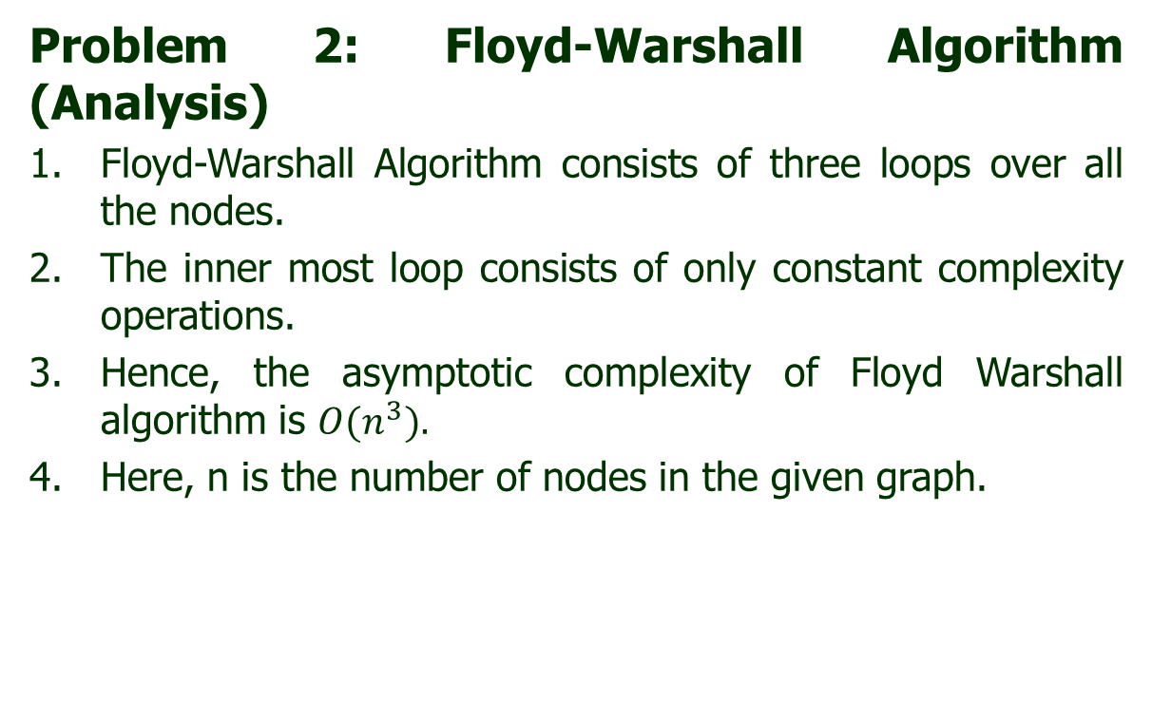
Dynamic Programming
Problem 2: Floyd-Warshall Algorithm (Analysis)
Floyd-Warshall Algorithm consists of three loops over all the nodes.
The inner most loop consists of only constant complexity operations.
Hence, the asymptotic complexity of Floyd Warshall algorithm is $O(n^{3}).$
Here, n is the number of nodes in the given graph.

Slide 111

Thank U

